Slide 1
State of MOOCs,
State of MOOC Research
Curtis J. Bonk| cjbonk@Indiana.edu
Meina Zhu| meinzhu@iu.edu
Instructional Systems Technology Dept.
Indiana University Bloomington
March 8, 2019

Slide 2

Talk Outline
  MOOC Weird Stuff
  MOOC Systematic Literature Review
  MOOC ID Considerations and Challenges
  MOOC ID for Self-directed Learning
  Others

Slide 3
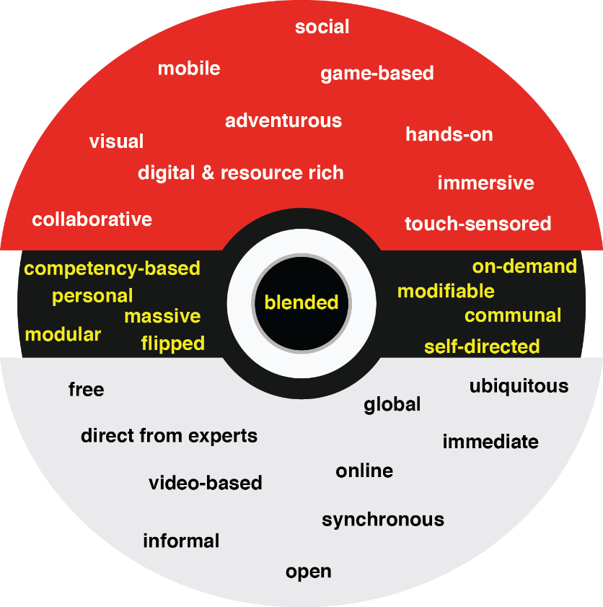
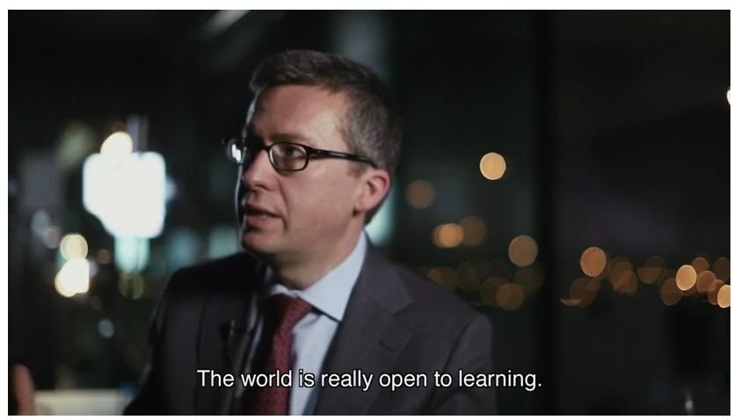
30+ Ways Learning is Changing:
The Three Mega Trends:
Engagement, Access, and Customization

Slide 4


Polls
Poll #1: Who in here has taken a MOOC?
Poll #2: Are you happy or frustrated when you take a MOOC?

Slide 5
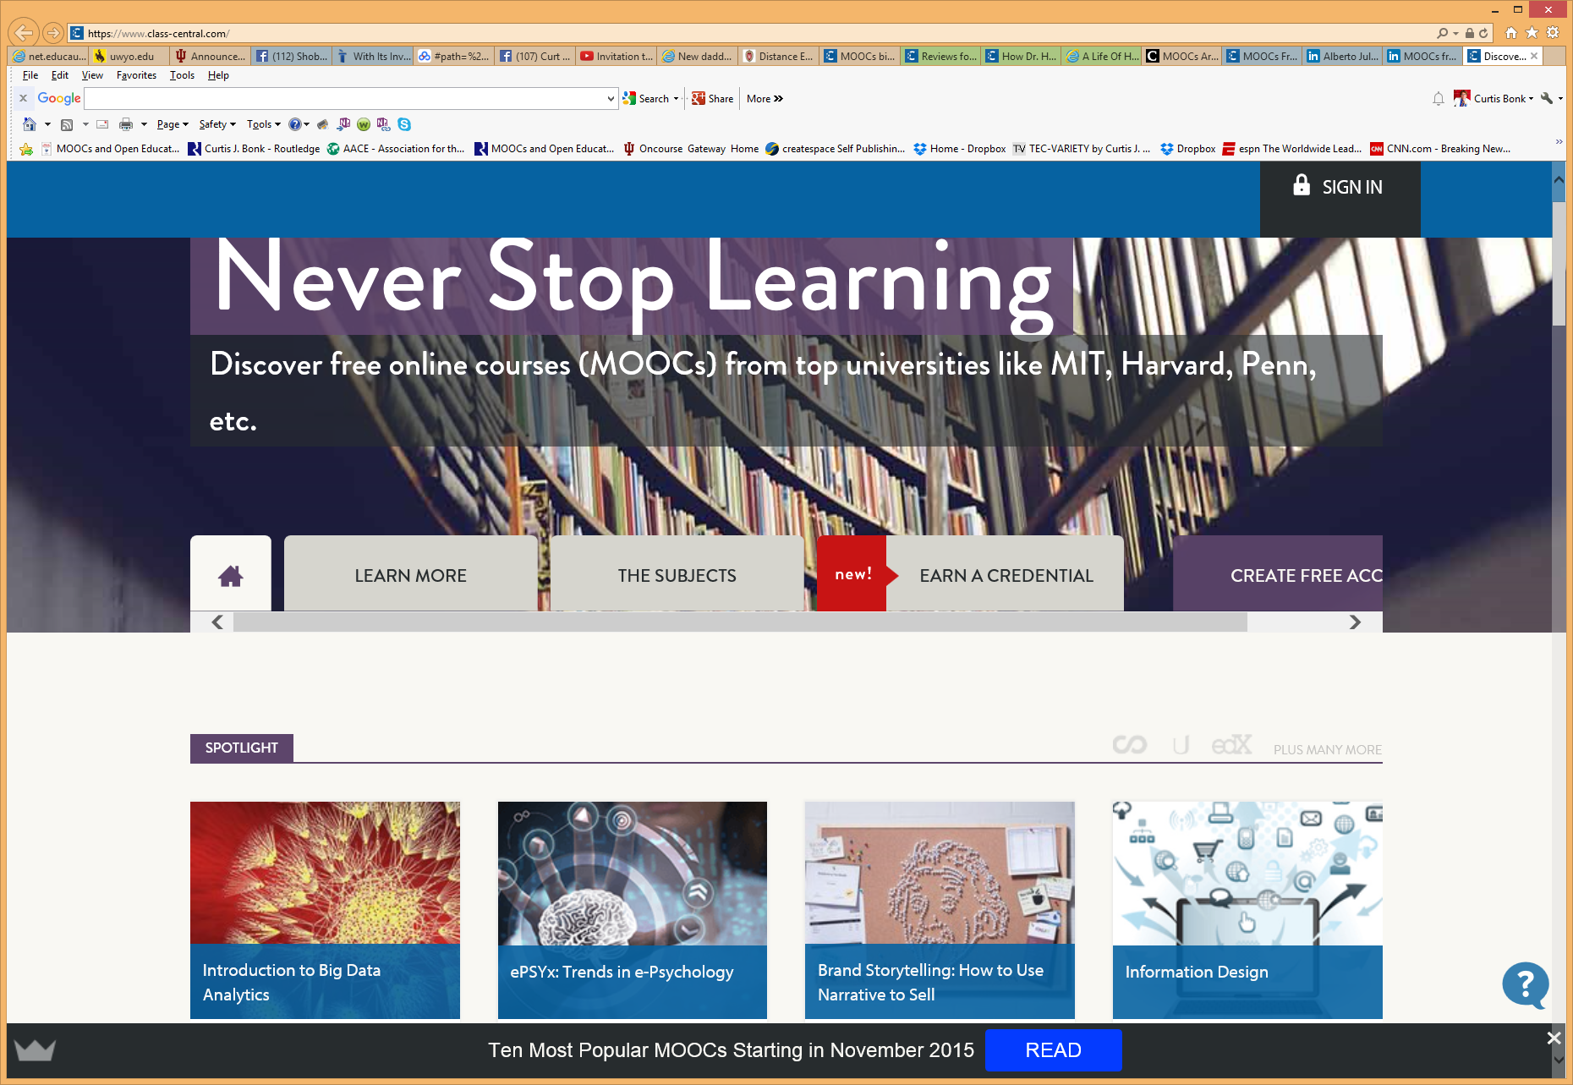



Some Weird Things Going On…

Slide 6


Weirdness #1…We’re Teaching the World
October, 2018
Sarah Fister Gale, CLO https://magazine.clomedia.com/issue/october-2018/teaching-the-world/ https://magazine.clomedia.com/issue/october-2018/

Slide 7
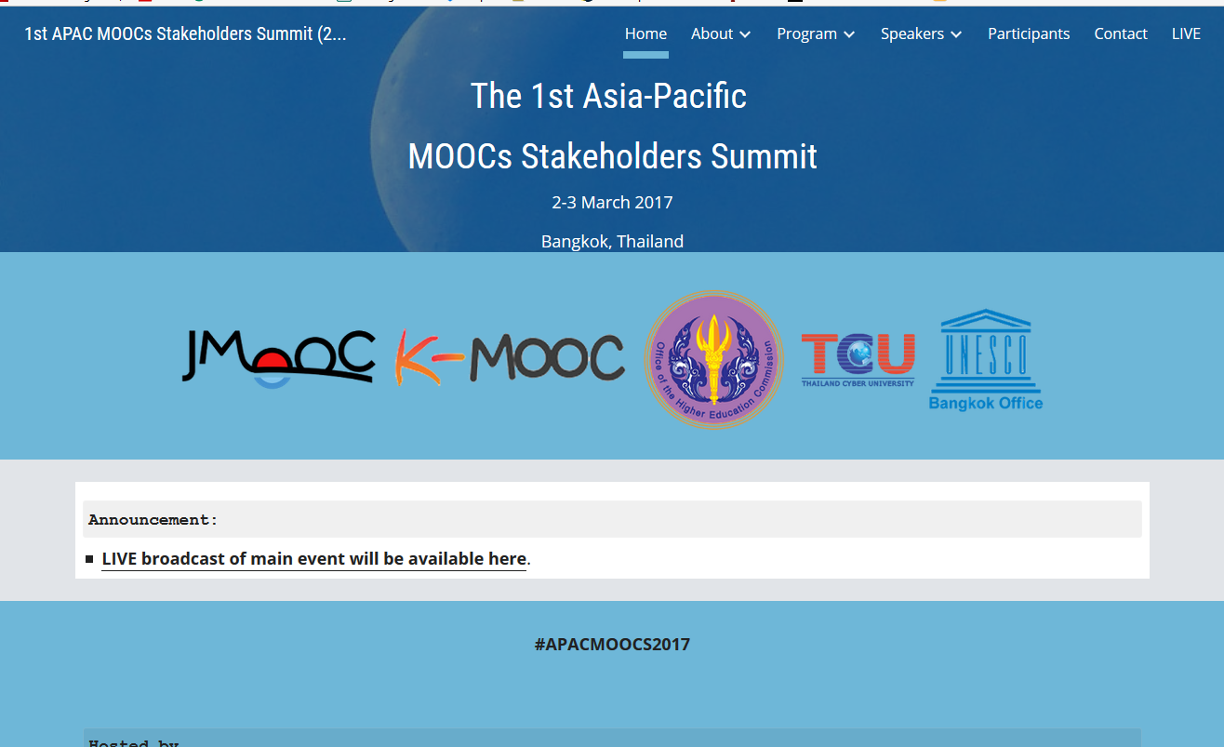

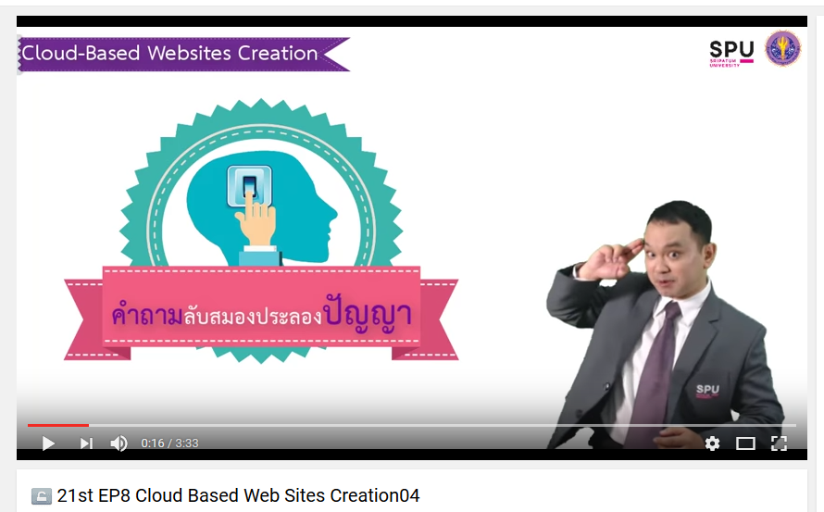

Weirdness #2: Your Friends are doing MOOCs
June 15, 2017
Massive List of MOOC Providers Around The World, Class Central
JMOOC, K-MOOC, and T-MOOC? https://www.class-central.com/report/mooc-providers-list/

Slide 8

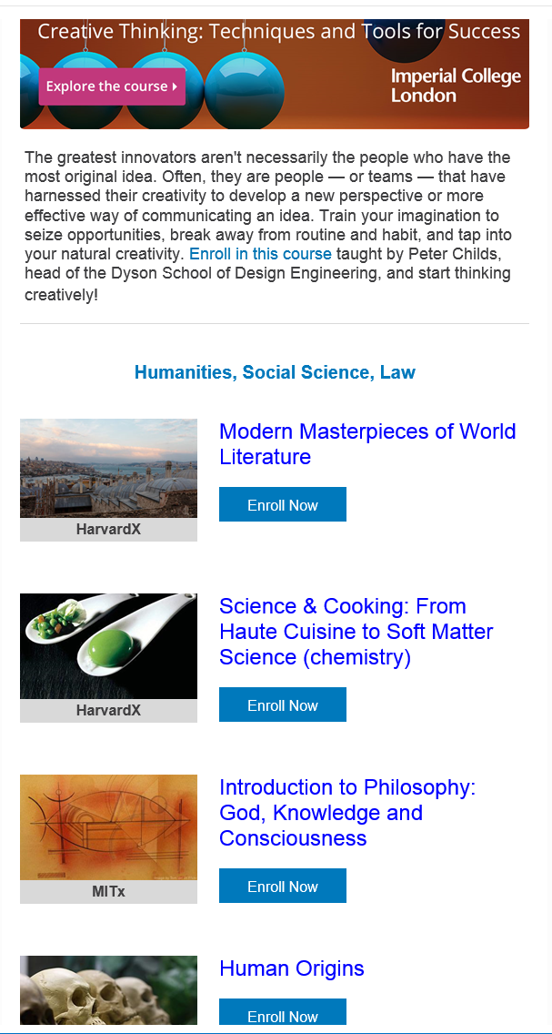
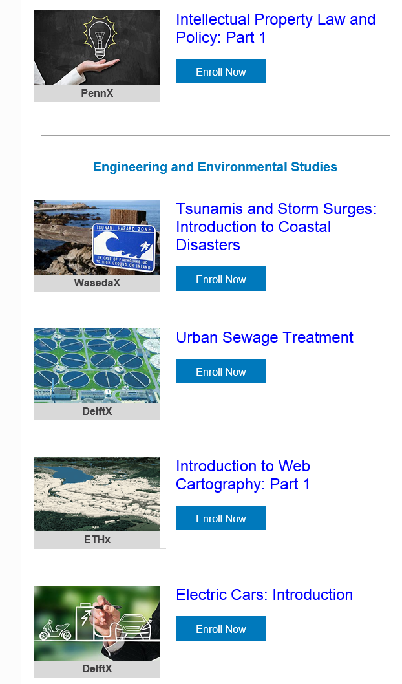
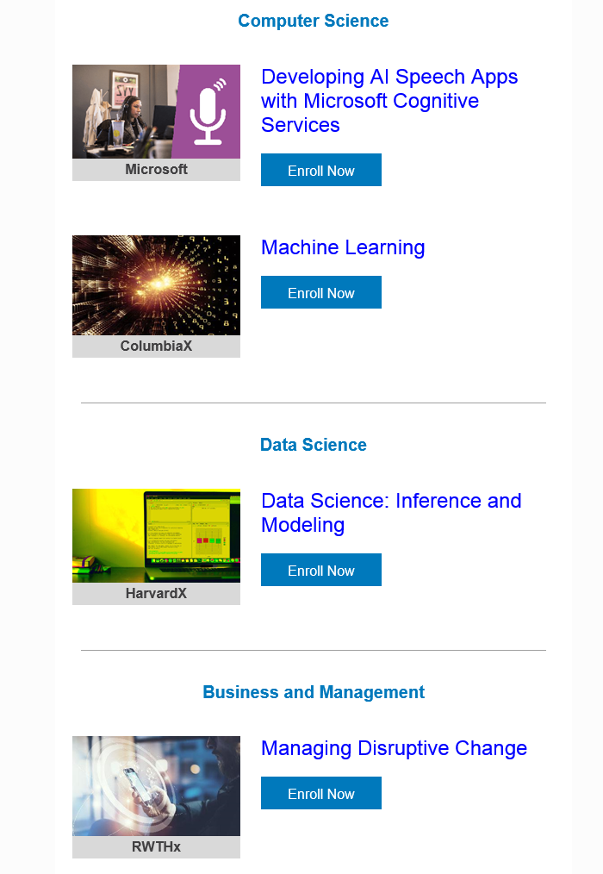
Weirdness #3: Summer MOOC Discounts
Email inbox: June 10, 2018
edX (Summer discounts)
https://www.edx.org/course

Slide 9

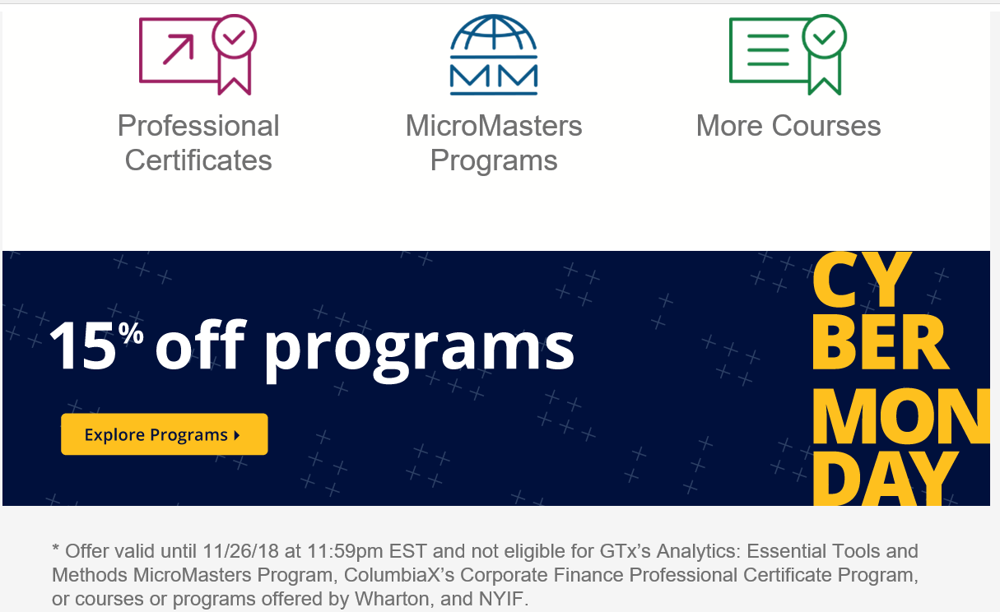
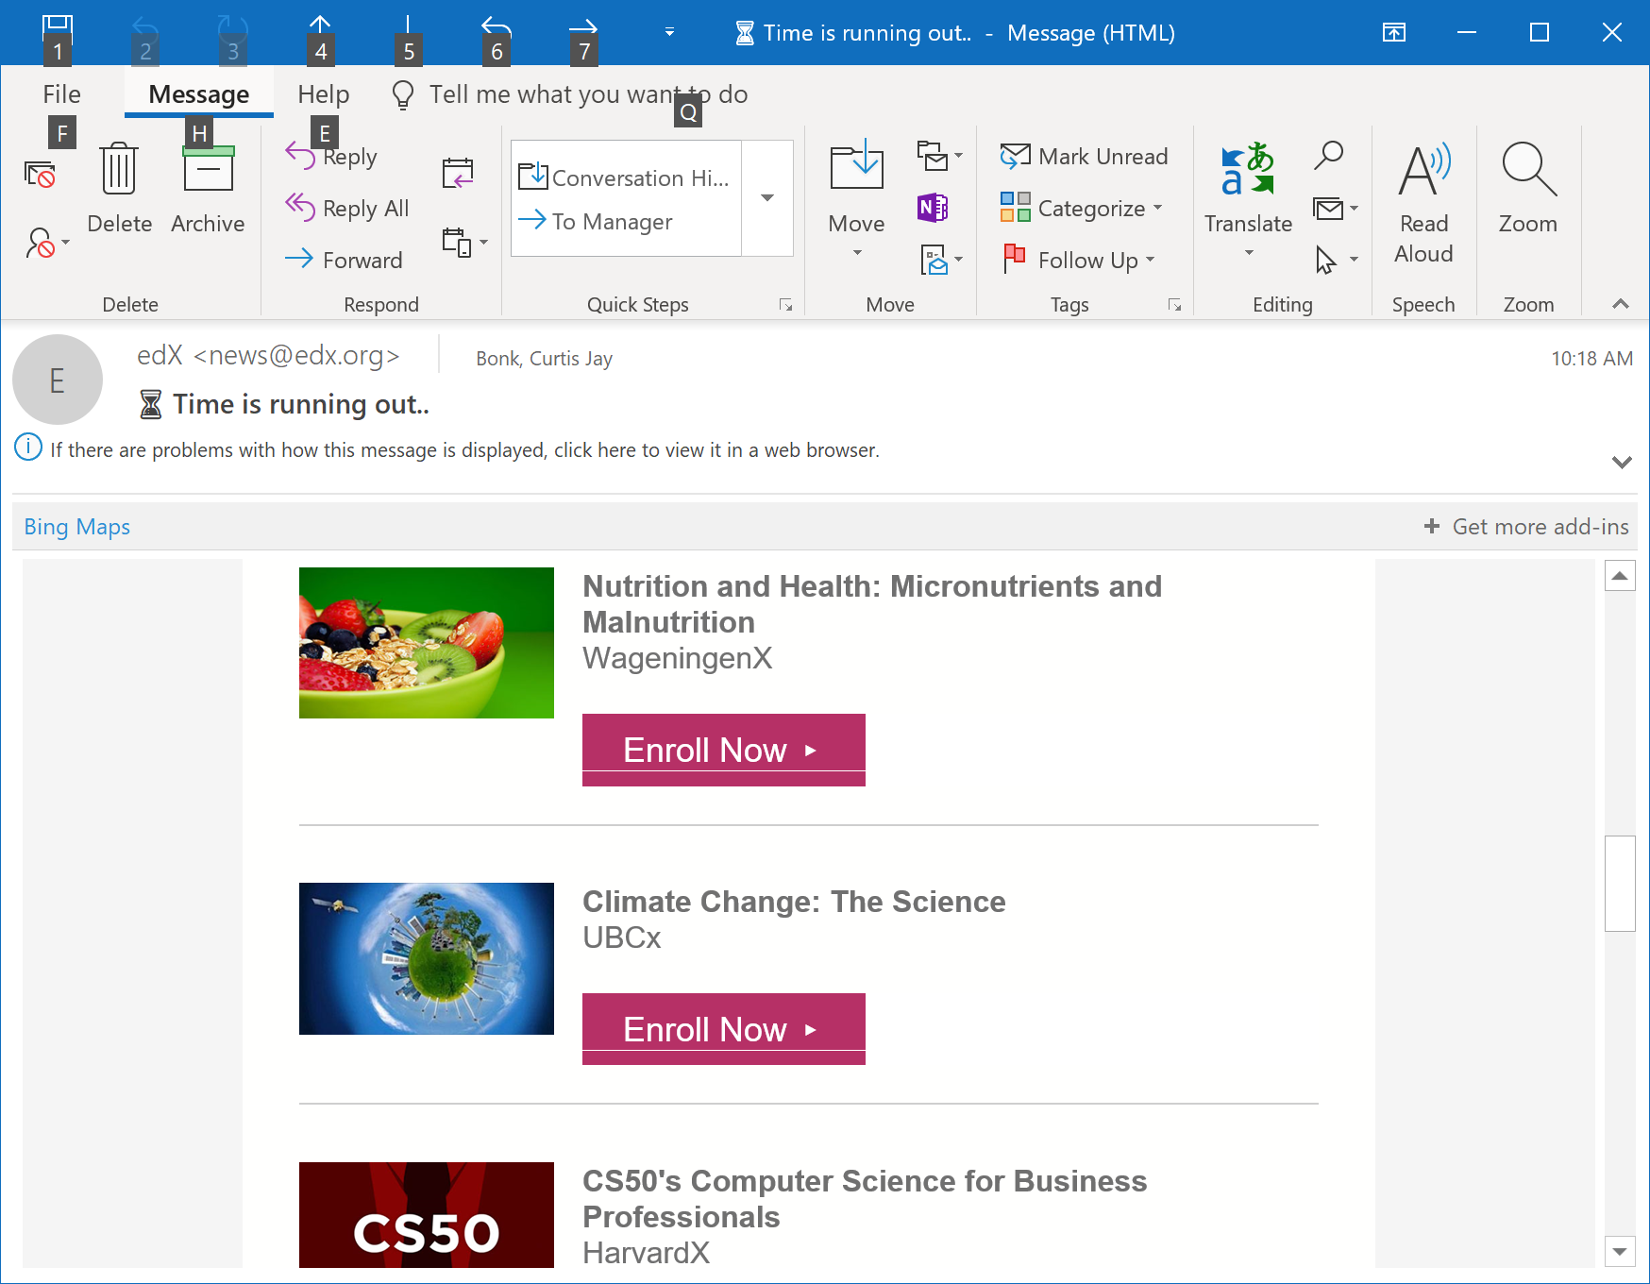
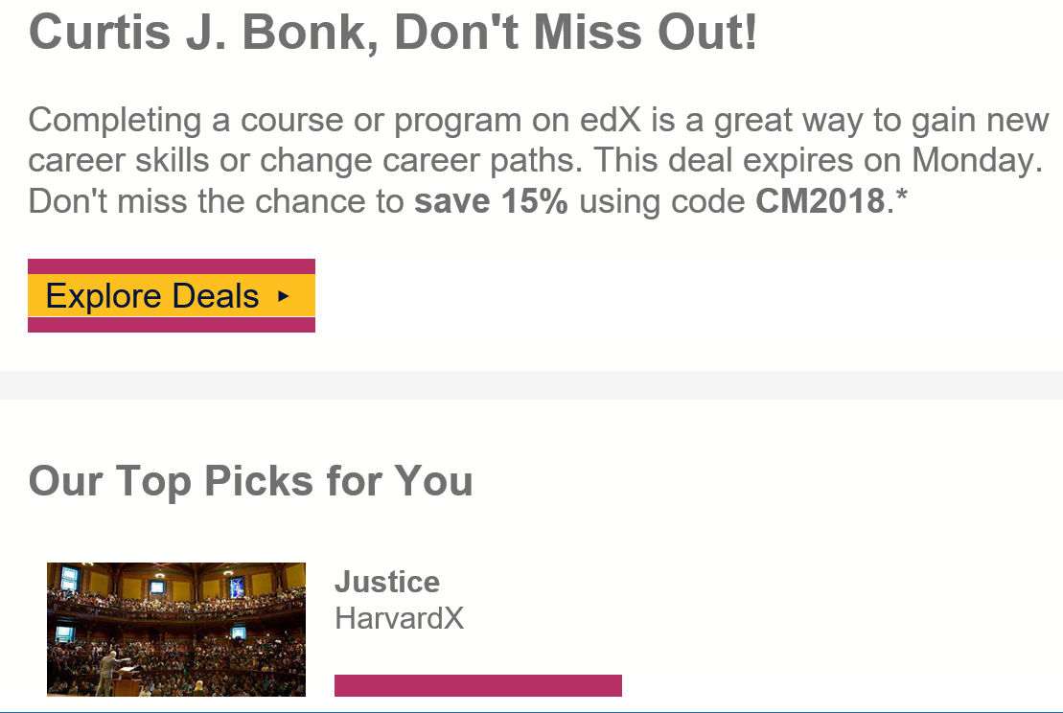
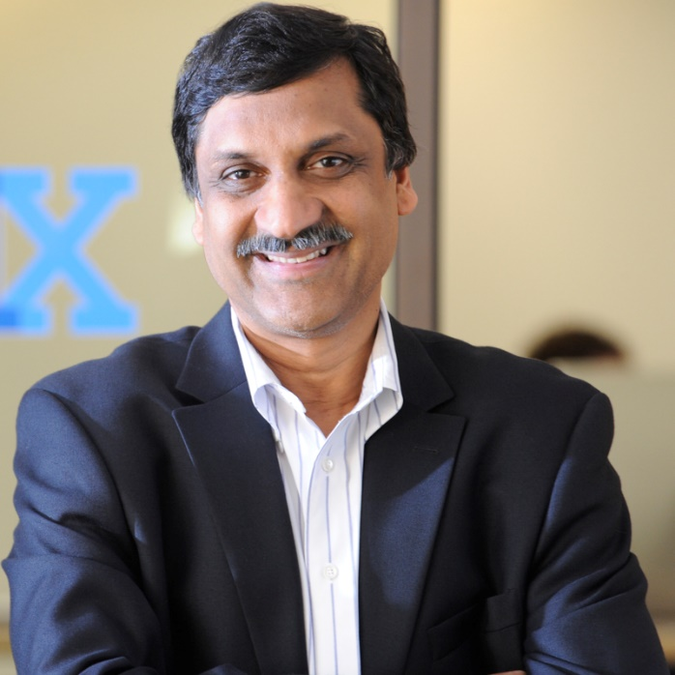
Weirdness #4: Cyber Monday Discounts
Email inbox: November 26, 2018
edX (Summer discounts)
https://www.edx.org/course

Slide 10
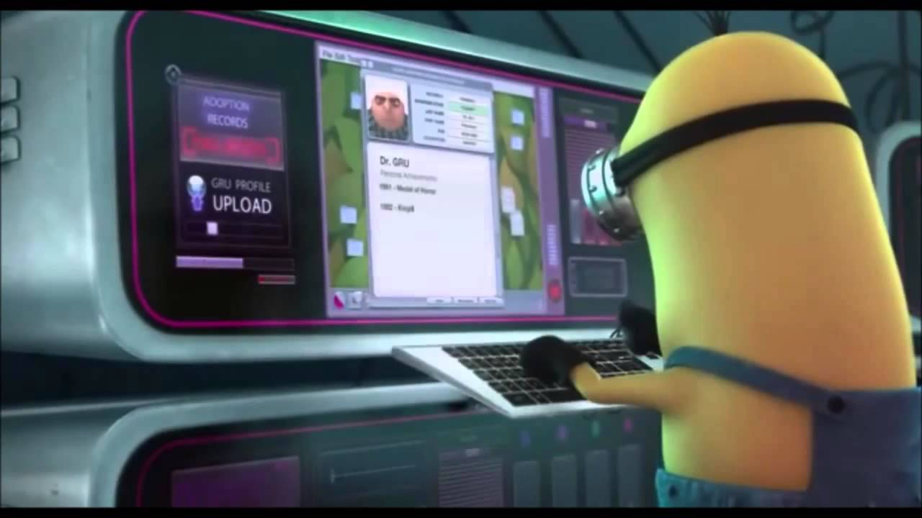
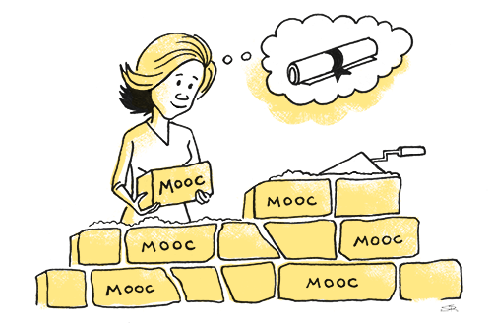

Weirdness #5…The MOOC Wave
May 21, 2018
The Second ave of MOOC Hype Is Here, and It’s Online Degrees
Dhawal Shah, Class Central
https://www.edsurge.com/news/2018-05-21-the-second-wave-of-mooc-hype-is-here-and-it-s-online-degrees

Slide 11


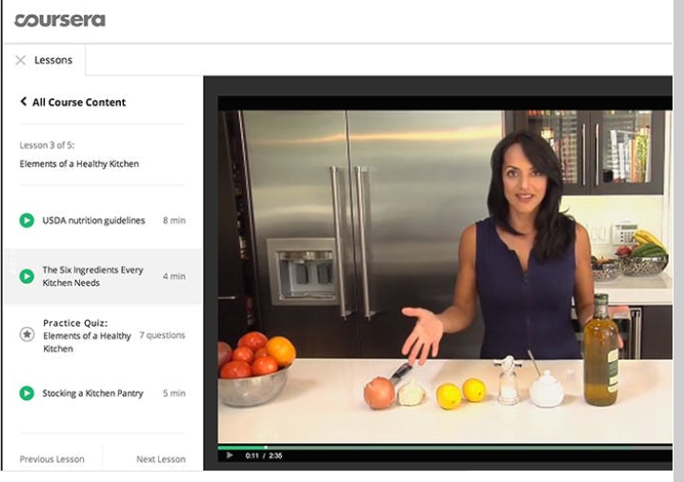
September 12, 2018
Coursera's CEO on the Evolving Meaning of 'MOOC’
Dian Schaffhauser, Campus Technology
https://campustechnology.com/articles/2018/09/12/courseras-ceo-on-the-evolving-meaning-of-mooc.aspx
Jeff Maggioncalda, Coursera CEO

Slide 12
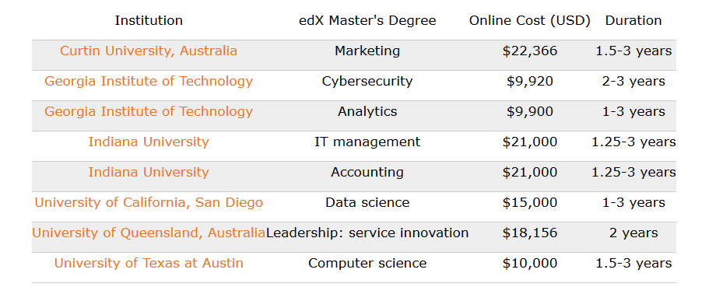
October 12, 2018
Weirdness #6…Degrees Via the MOOC
EdX: From MicroMasters to Online Master’s Degrees
Lindsey McKenzie, Inside Higher Ed
https://www.insidehighered.com/news/2018/10/12/edx-launches-nine-low-cost-online-degrees

Slide 13
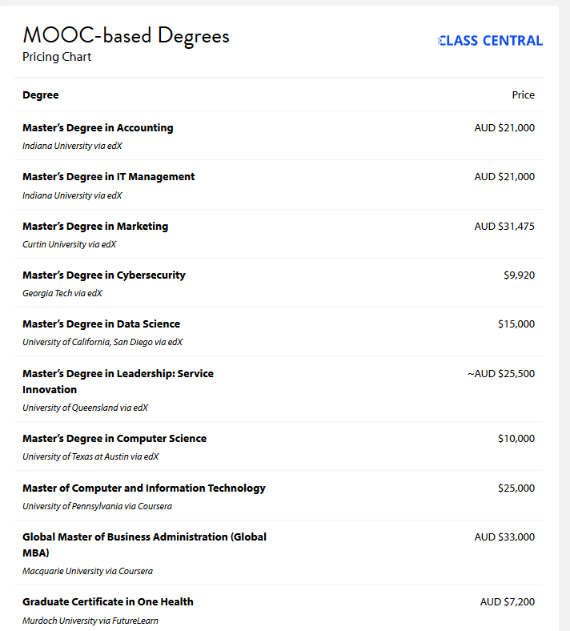
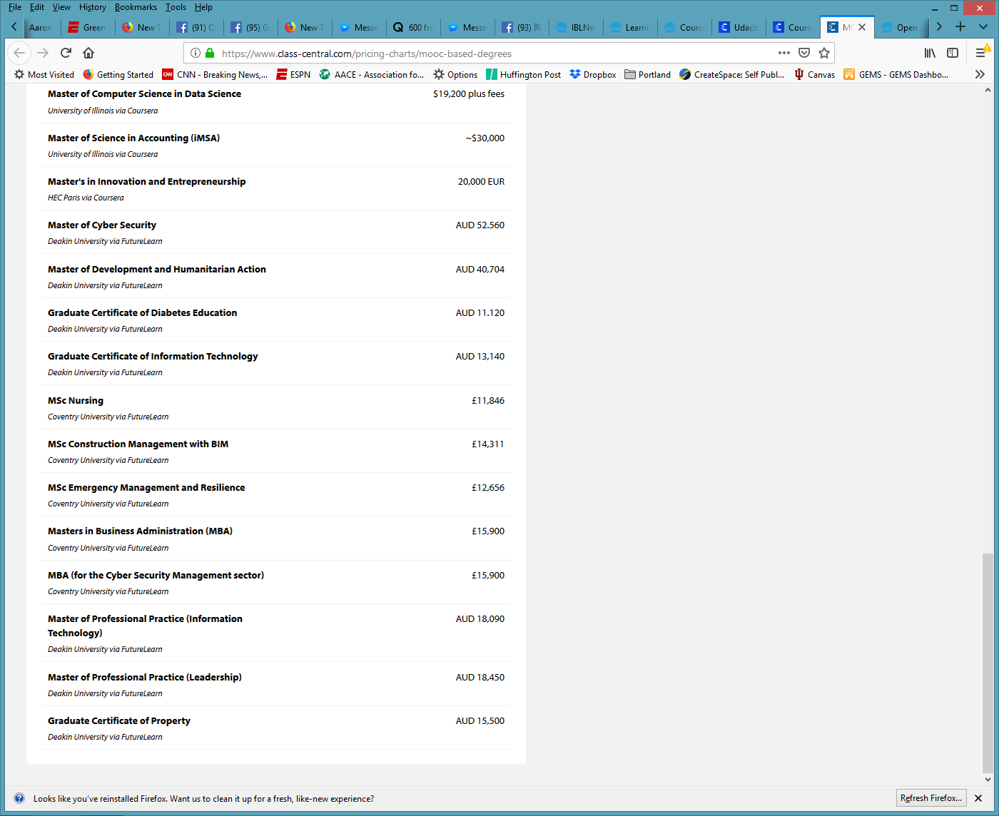
Weirdness #7…MOOC-based Pricing Charts
December 30, 2018
MOOC-Based Degrees, Pricing Chart
IBL News
https://www.class-central.com/pricing-charts/mooc-based-degrees

Slide 14



Weirdness #8…MOOCs in Wedding Announcements
September 26, 2018
The Future of Professional Credentialing ... in an Engagement Announcement
Joshua Kim, Inside Higher Ed
https://www.insidehighered.com/digital-learning/blogs/technology-and-learning/future-professional-credentialing-engagement

Slide 15
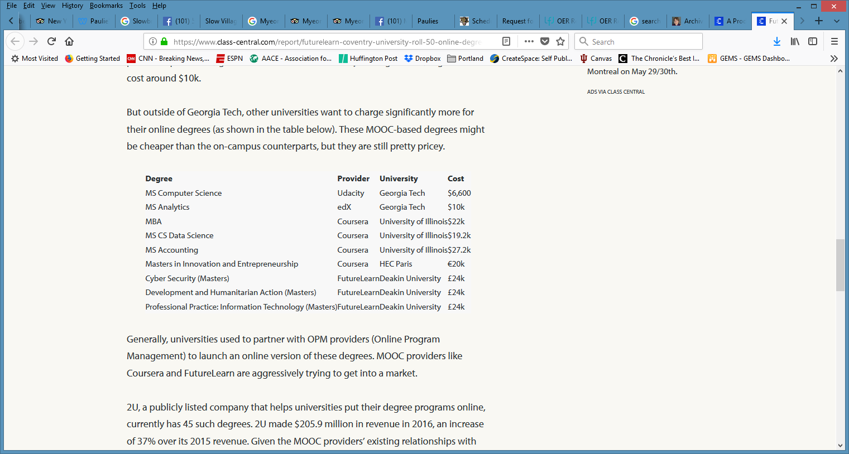
Weirdness #9…Discounted MOOC-based MBAs
August 7, 2017
FutureLearn and Coventry University to Roll Out 50 Online Degrees (Last year Deakin University announced a similar partnership with FutureLearn)
Class Central, Dhawal Shah
https://www.class-central.com/report/futurelearn-coventry-university-roll-50-online-degrees/

Slide 16
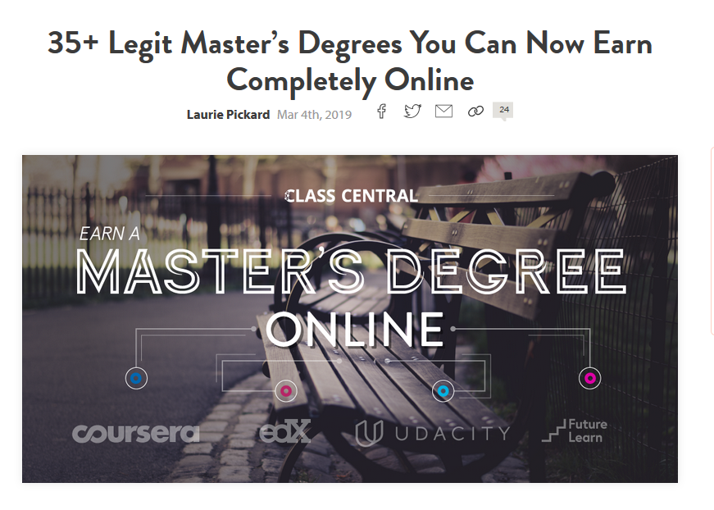
March 4, 2019
Weirdness #10…35+ Legit Master’s Degrees You Can Now Earn Completely Online
Laurie Pickard, Class Central https://www.class-central.com/report/mooc-based-masters-degree/

Slide 17
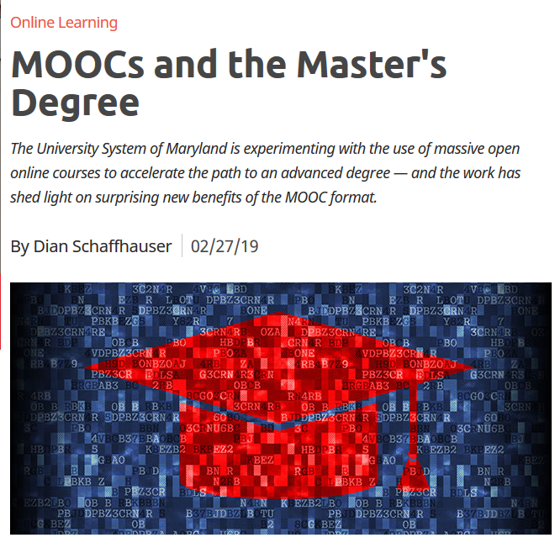
February 27, 2019
MOOCs and the Master's Degree
Dian Schaffhauser, Campus Technology https://campustechnology.com/articles/2019/02/27/moocs-and-the-masters-degree.aspx

Slide 18

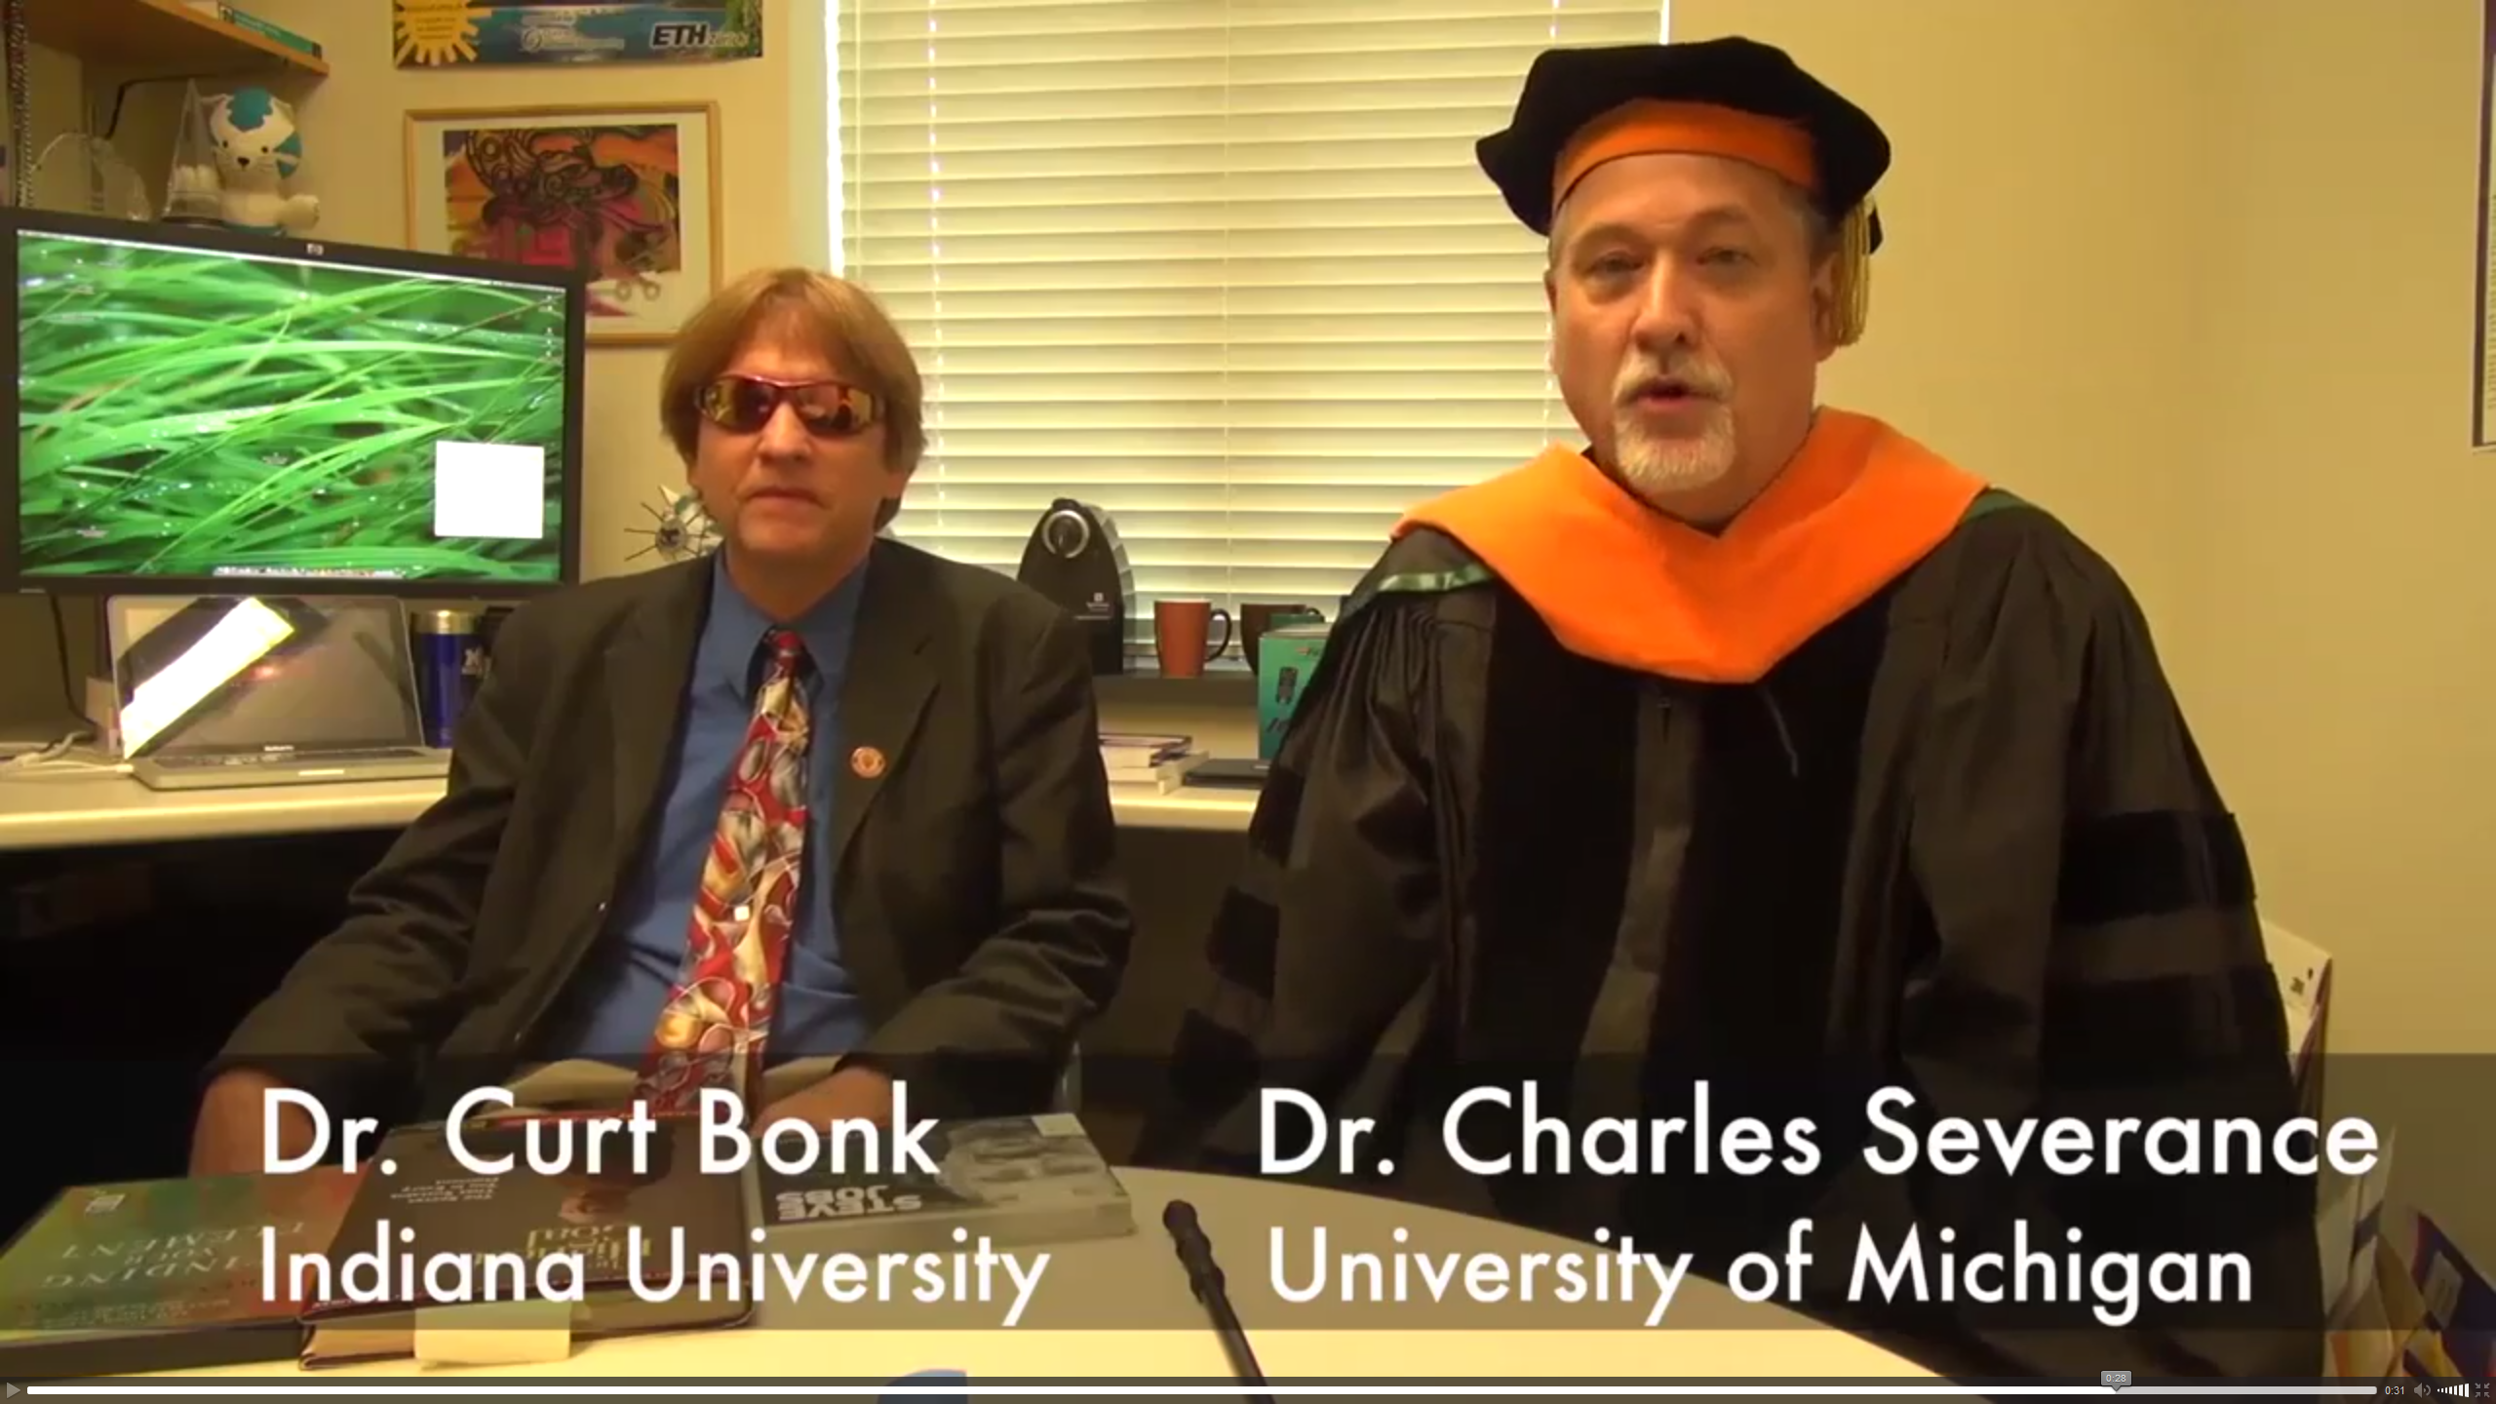
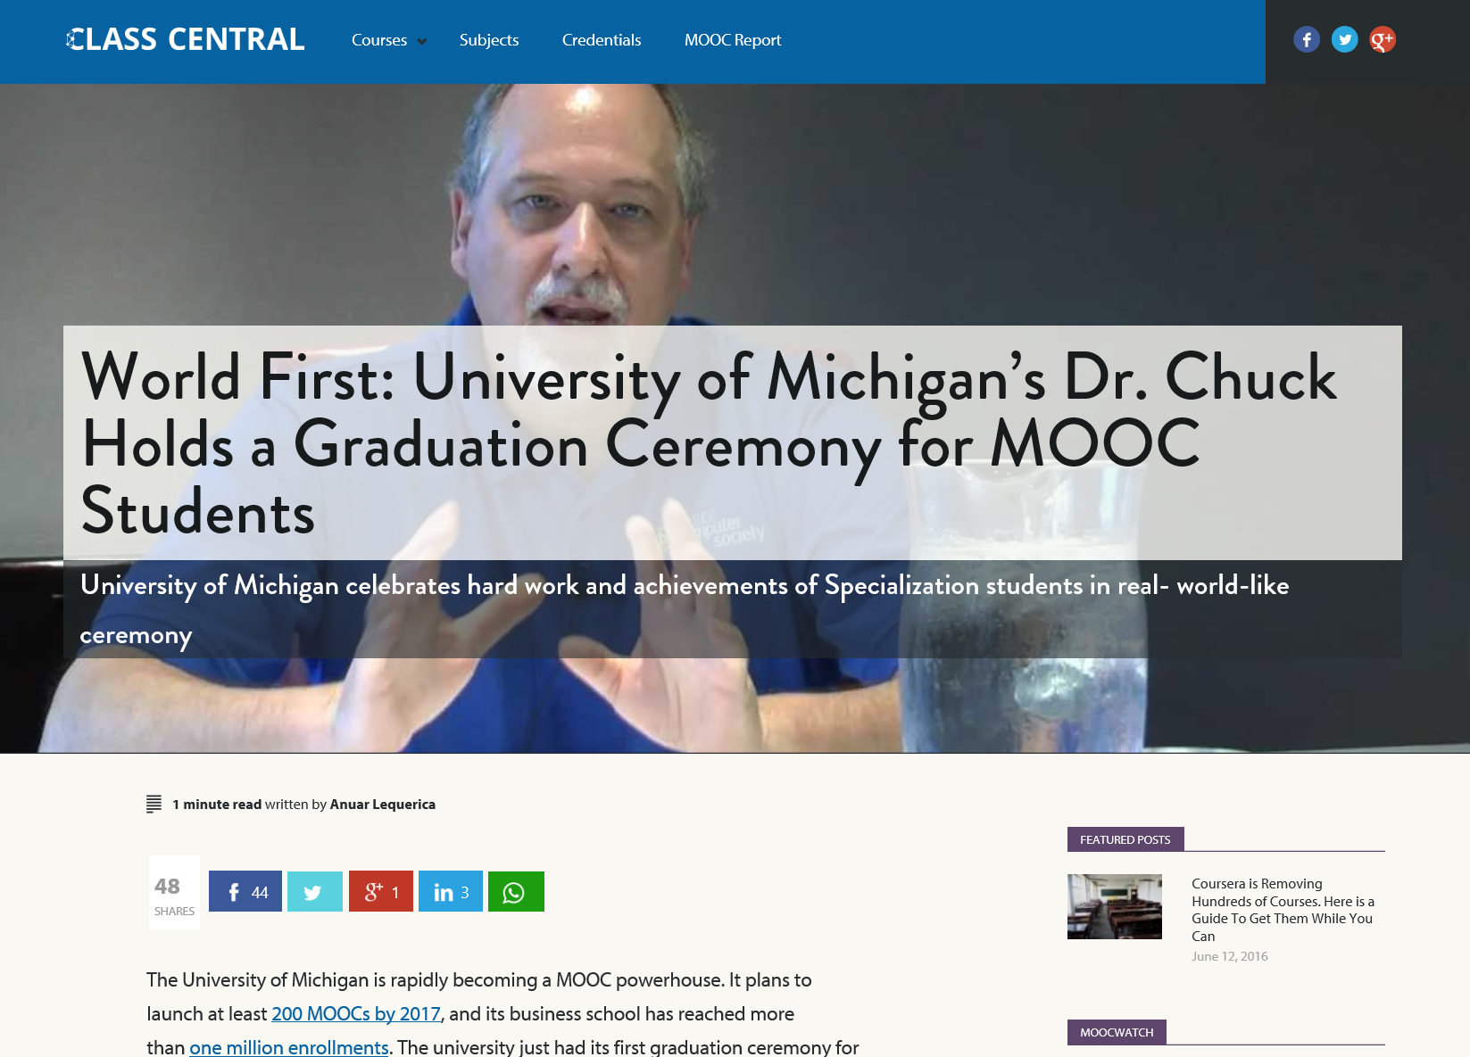
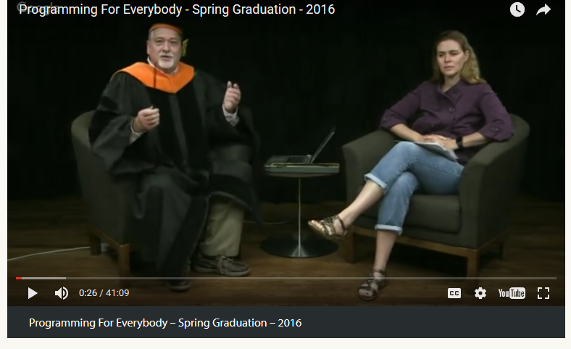
June 14, 2016 (Customization)
Chapter 15: Learning About MOOCs by Talking to Students
Charles Severance, Univ. of Michigan
Anuar Lequerica, Class Central https://www.class-central.com/report/dr-chuck-graduate-ceremony-python-specialization/

Slide 19

MOOC Trends and Recent Data

Slide 20
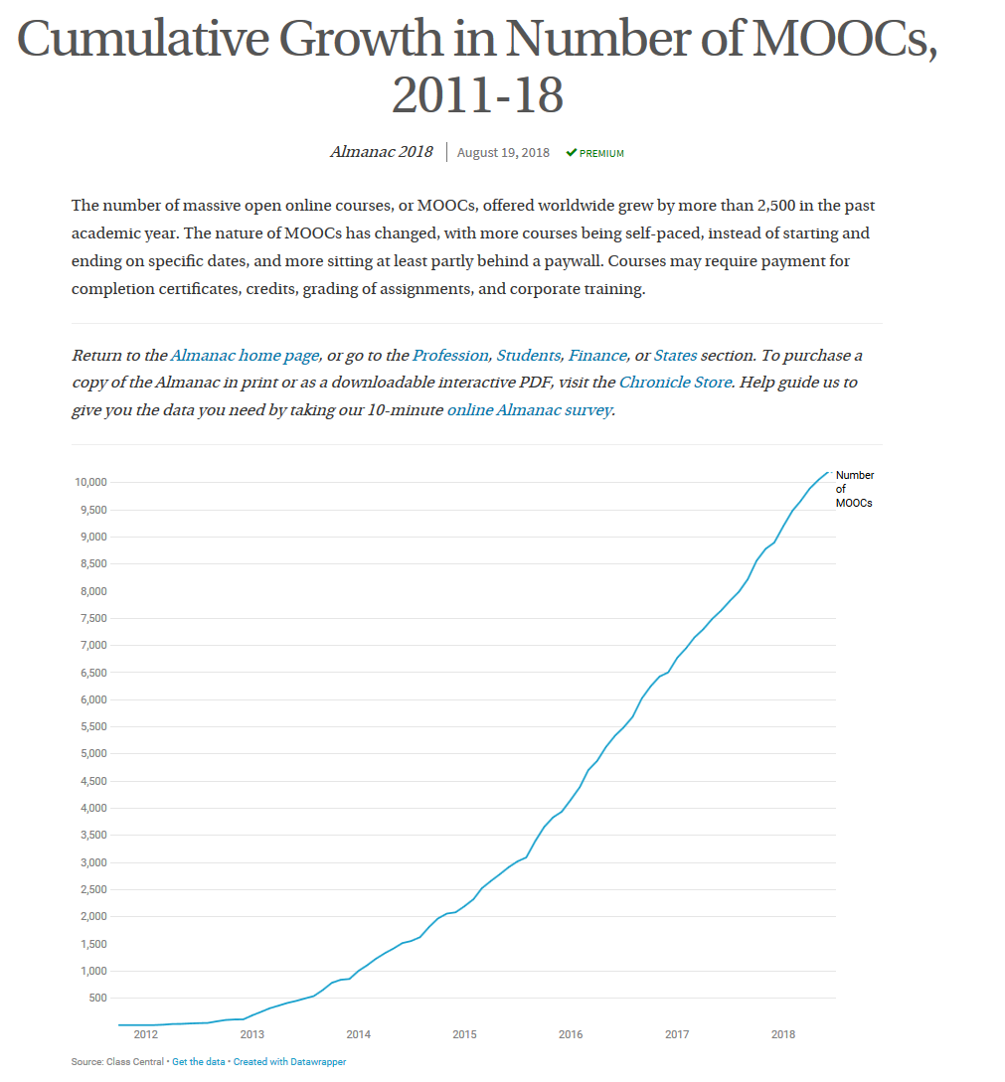

MOOCs are not dead
August 19, 2018
Cumulative Growth in Number of MOOCs, 2011-18
Almanac 2018, Chronicle of Higher Education
https://www.chronicle.com/article/Top-5-MOOC-Providers-by-Number/244090?cid=cp216

Slide 21
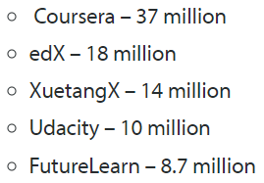
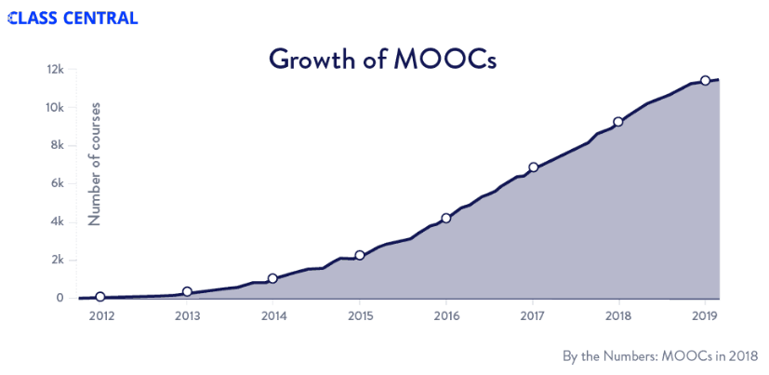

MOOCs Trends
Year of MOOC-based Degrees: A Review of MOOC Stats and Trends in 2018, Dhawal Shah, Class Central--January 6, 2019
Top five MOOC providers

Slide 22
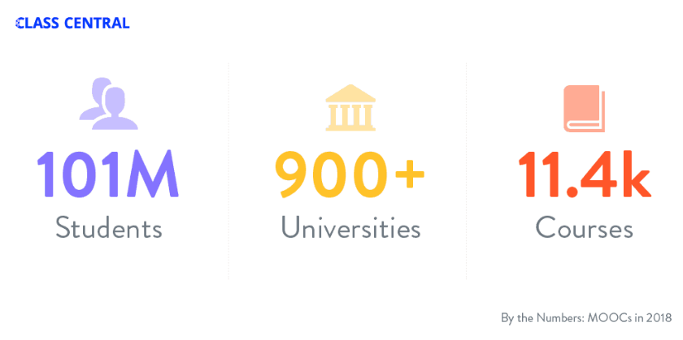
MOOCs Stats
Year of MOOC-based Degrees: A Review of MOOC Stats and Trends in 2018, Dhawal Shah, Class Central--January 6, 2019

Slide 23
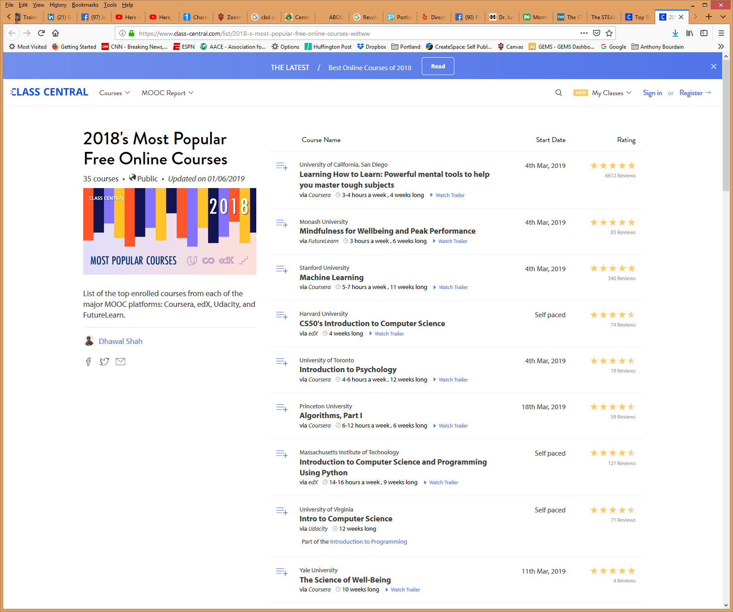
MOOCs Stats
2018's Most Popular Free Online Courses, : Coursera, edX, Udacity, and FutureLearn.
Dhawal Shah, Class Central--January 6, 2019
https://www.class-central.com/list/2018-s-most-popular-free-online-courses-wdtww

Slide 24
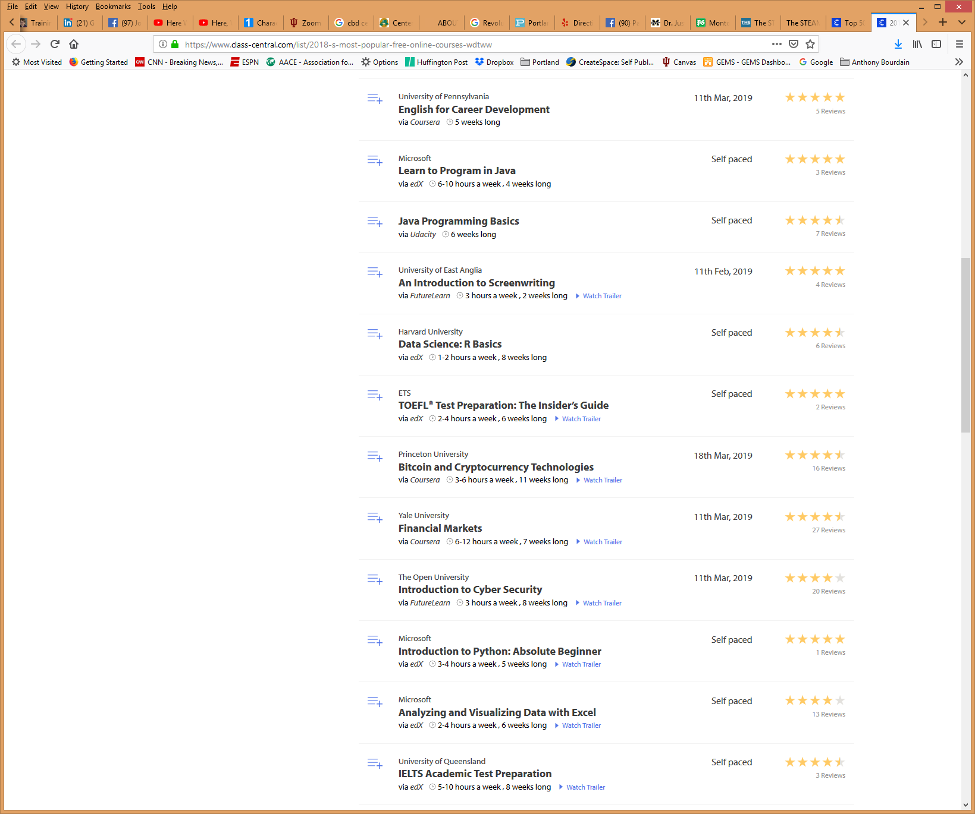
MOOCs Stats
2018's Most Popular Free Online Courses, : Coursera, edX, Udacity, and FutureLearn.
Dhawal Shah, Class Central--January 6, 2019
https://www.class-central.com/list/2018-s-most-popular-free-online-courses-wdtww

Slide 25
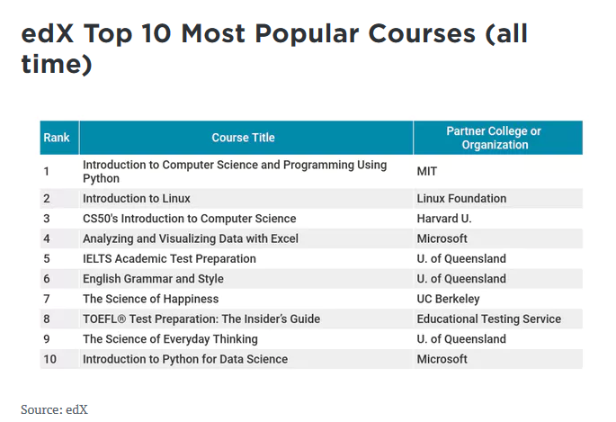
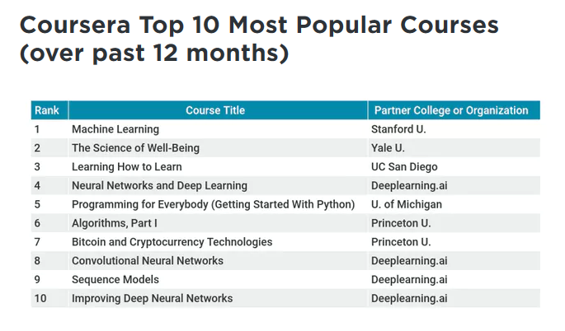
June 19, 2018
How Blockbuster MOOCs Could Shape the Future of Teaching
Jeffrey R. Young, EdSurge https://www.edsurge.com/news/2018-06-19-how-blockbuster-moocs-could-shape-the-future-of-teaching

Slide 26

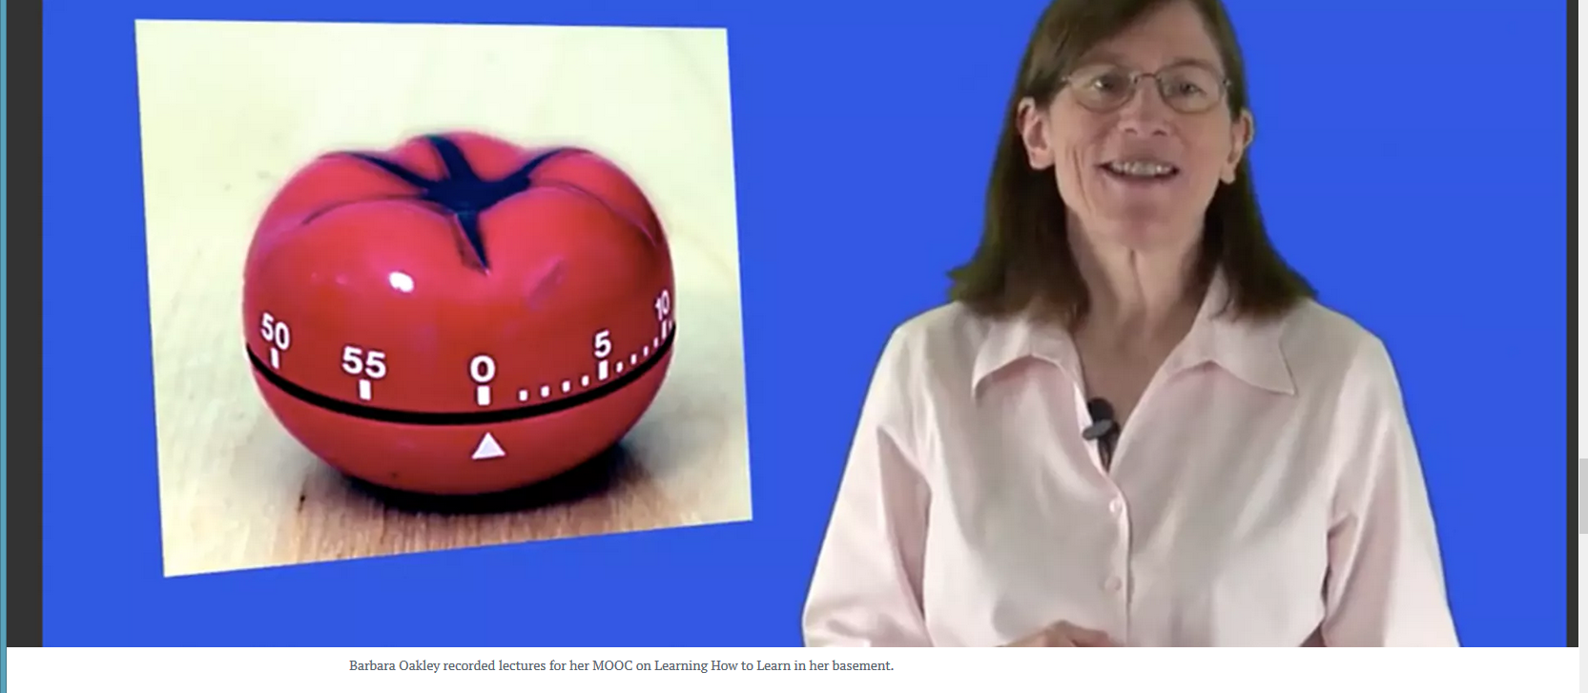
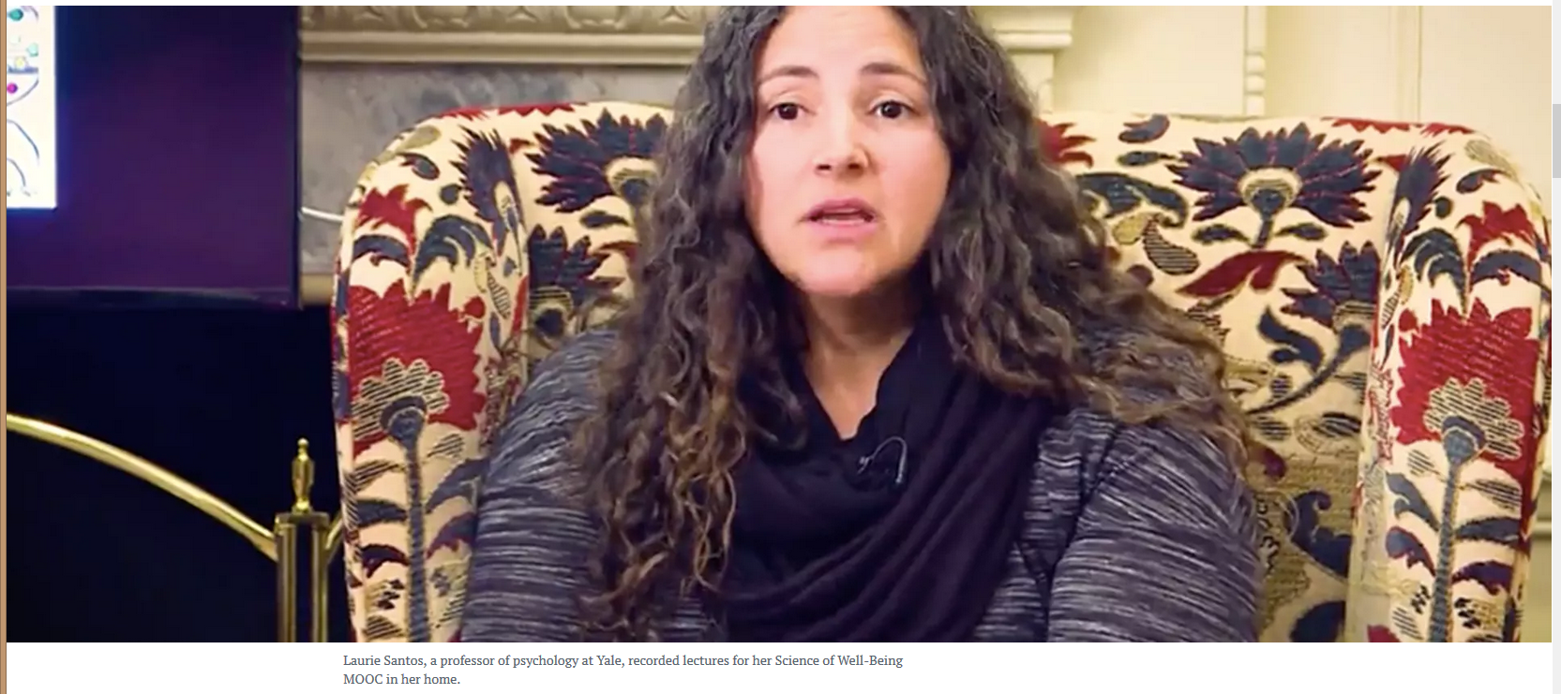
June 19, 2018
How Blockbuster MOOCs Could Shape the Future of Teaching
Jeffrey R. Young, EdSurge https://www.edsurge.com/news/2018-06-19-how-blockbuster-moocs-could-shape-the-future-of-teaching

Slide 27
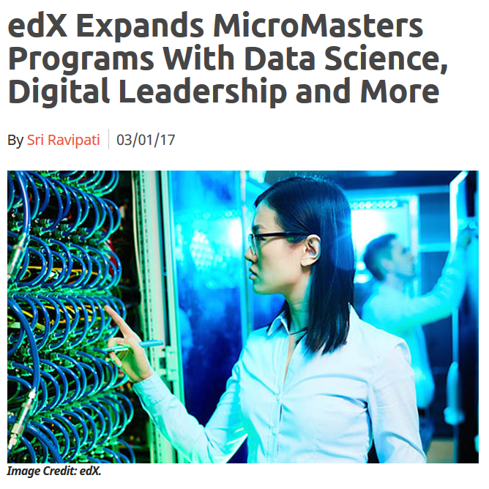

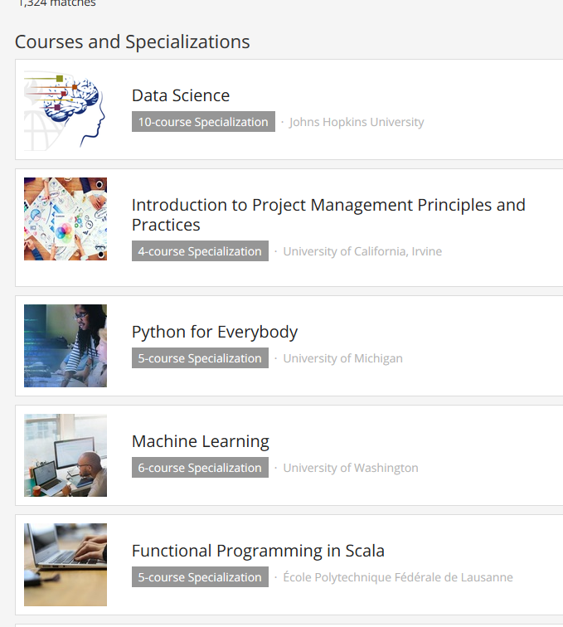
October 12, 2018
Microcredentials and Nanodegrees
Learning is More on Modular edX Expands MicroMasters Programs With Data Science (“nanodegrees”)
Digital Leadership and More, Sri Ravipati, Campus Technology https://campustechnology.com/articles/2017/03/01/edx-expands-micromasters-programs-with-data-science-digital-leadership-and-more.aspx
Lindsey McKenzie, Inside Higher Ed https://www.insidehighered.com/news/2018/10/12/edx-launches-nine-low-cost-online-degrees

Slide 28
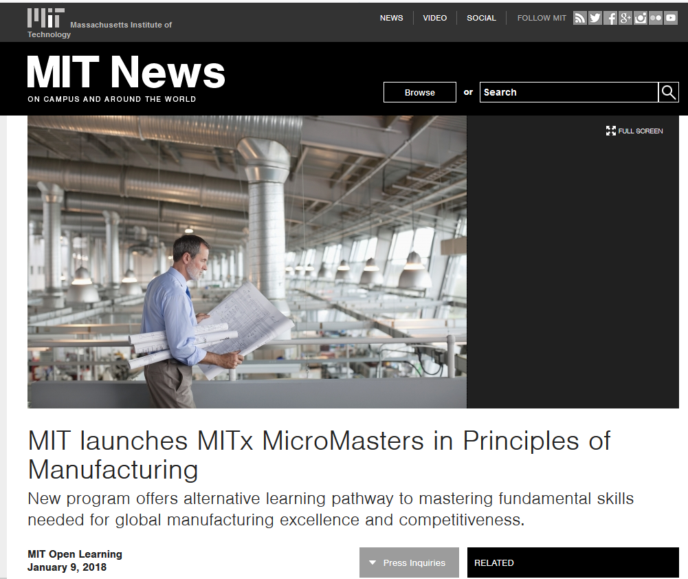
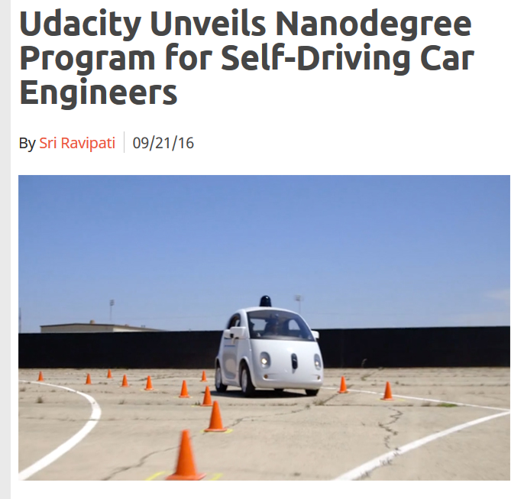
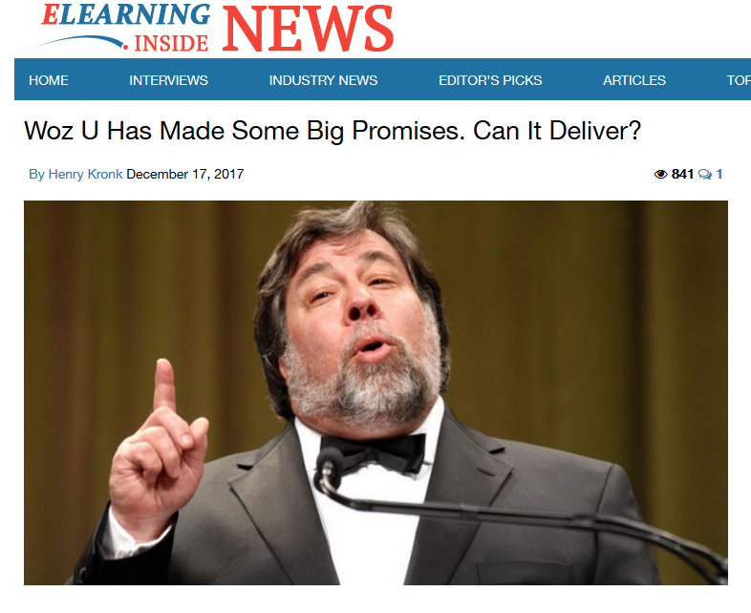

January 9, 2018
MicroMaster’s Degrees
Learning is More on Modular
MIT launches MITx MicroMasters in Principles of Manufacturing, MIT Open Learning http://news.mit.edu/2018/mit-launches-new-mitx-micromasters-program-principles-manufacturing-0109

Slide 29

December 7, 2018
Reinventing the College Degree: A Future with Modular Credentials
IBL News https://iblnews.org/2018/12/07/reinventing-the-college-degree-a-future-with-modular-credentials/

Slide 30
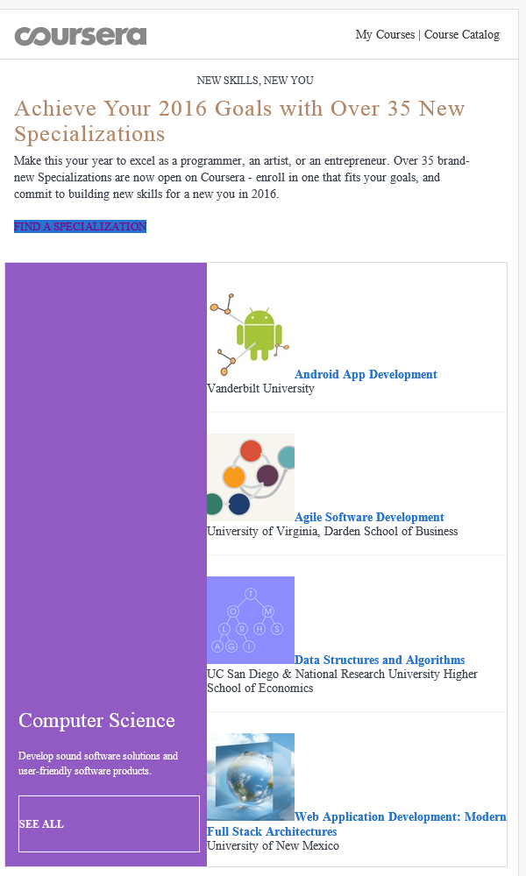
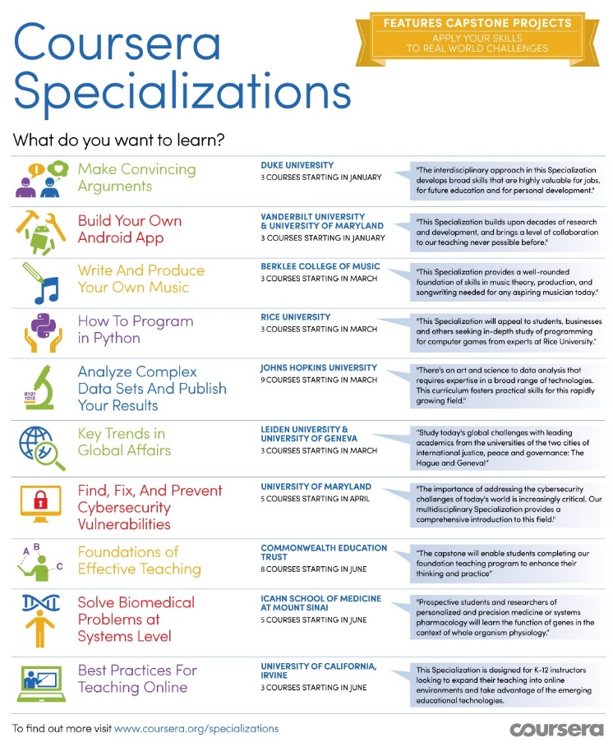

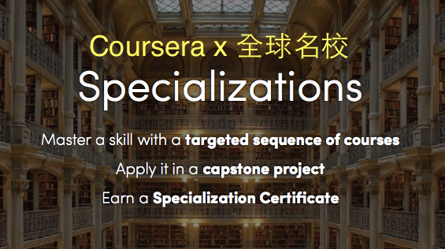
January 20, 2016
Coursera Specializations https://www.coursera.org/browse?utm_medium=email&utm_source=marketing&utm_campaign=aUAR4L-fEeW6i-NodUB9Qw&languages=en

Slide 31

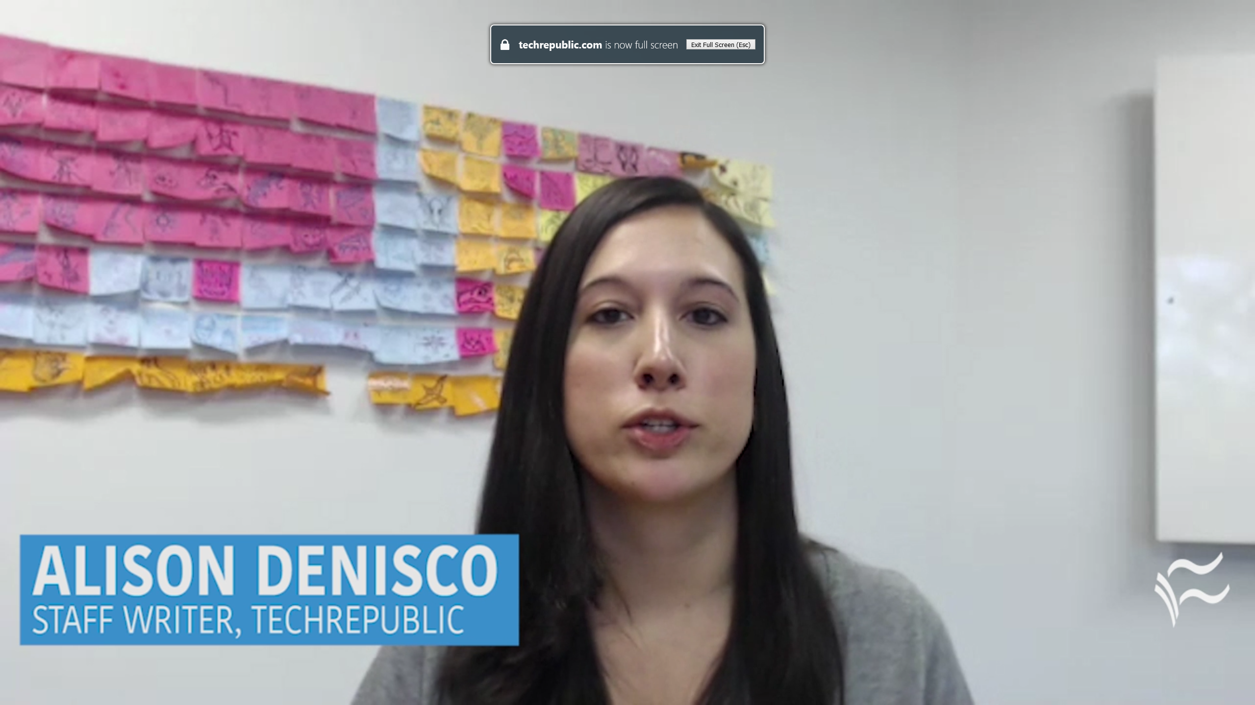
October 30, 2017
MOOCs ramp up new fields
Report: 59% of employed data scientists learned skills on their own or via a MOOC
Alison DeNisco Rayome https://www.techrepublic.com/article/report-59-of-employed-data-scientists-learned-skills-on-their-own-or-via-a-mooc/

Slide 32
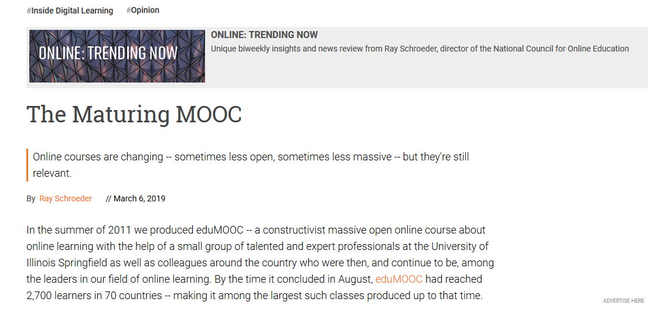
March 6, 2019
The Maturing MOOC
Ray Schroeder, Inside Higher Ed https://www.insidehighered.com/digital-learning/blogs/online-trending-now/maturing-mooc

Slide 33
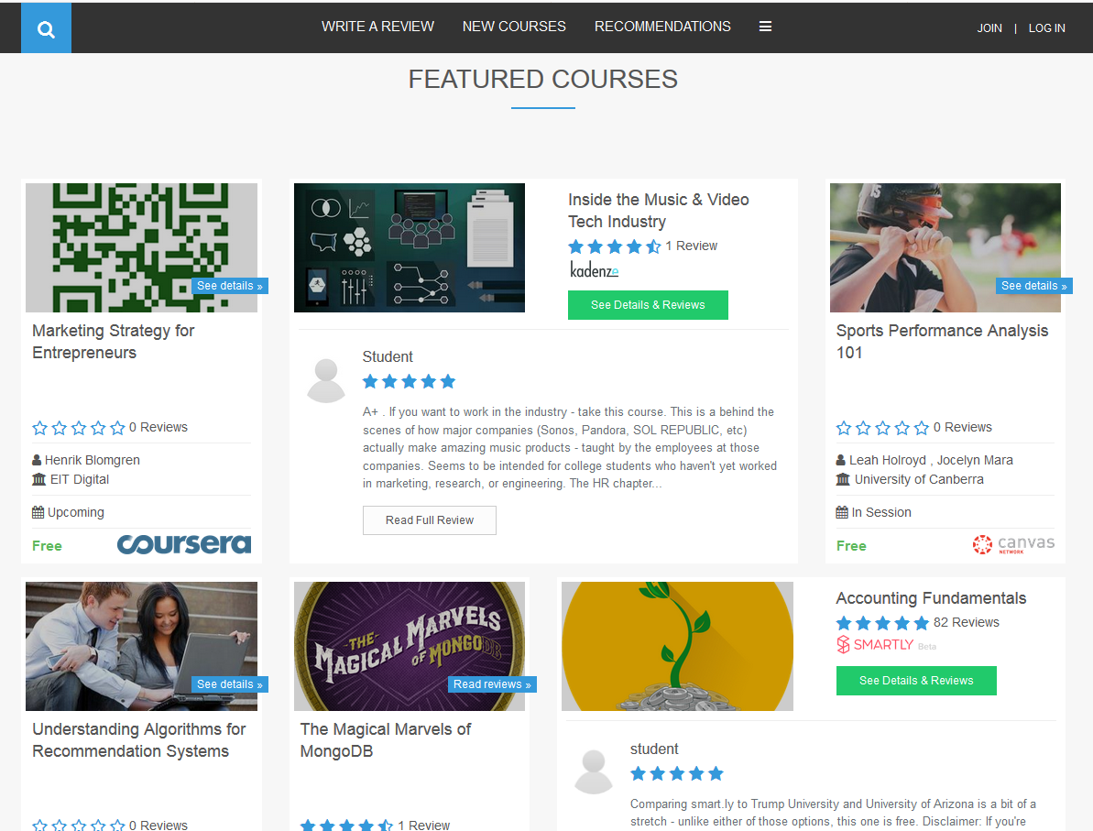
Khe Foon (Timothy) Hew (2018)
Hew, K. F. (2018). Unpacking the Strategies of Ten Highly Rated MOOCs: Implications for Engaging Students in Large Online Courses. Teachers College Record, 120(1).
https://www.coursetalk.com/
Hew’s (2018, p. 1) analyzed 4,565 coursetalk review comments of 10 highly rated MOOCs. He found “six key factors that can engage online [MOOC] participants and nine reasons for participant disaffection.”
Problem-centric learning supported by clear explanations.
Active learning supported by timely feedback (e.g., assignments, projects, discussion).
Course resources that cater to participants’ learning needs or preferences.
Instructor attributes (e.g., passion, enthusiasm, humor, variety of examples).
Peer interaction.
Instructor availability.

Slide 34

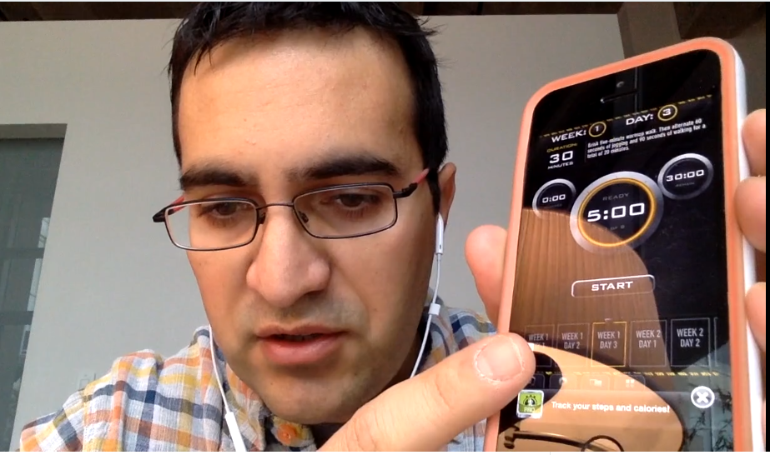

Quotes: Veletsianos et al. (2015-2016)
“To gain a deeper and more diverse understanding of the MOOC phenomenon, researchers need to use multiple research approaches (e.g., ethnography, phenomenology, discourse analysis) add content to them.” (p. 583)
Veletsianos, Collier, & Schneider (2015, May), Digging deeper into learners’ experiences in MOOCs: Participation in social networks outside of MOOCs, notetaking and contexts surrounding content consumption. BJET, 46(3), 570-587.
“Dependence on Particular Research Methods May Restrict our Understanding of MOOCs.”
George Veletsianos & Peter Shepherdson’s Study (2016). Systematic Analysis and Synthesis of the Empirical MOOC Literature Published in 2013-2015. IRRODL. http://www.irrodl.org/index.php/irrodl/article/view/2448/3655

Slide 35
Three Studies
Study #1
MOOC Literature Review
Study #3
MOOC Design for SDL
Study #2
MOOC Design Considerations and Challenges

Slide 36

Study #1
MOOCs
Literature Review
(2014-2016)
Zhu, M., Sari, A., & Lee, M. M. (2018). A Systematic Review of Research Methods and Topics of the Empirical MOOC Literature (2014-2016). The Internet and Higher Education, 37, 31-39.

Slide 37
Research Purposes & Questions
  The purpose was to gain a deeper and more diverse understanding of the current MOOC phenomenon and identify the gap in MOOC empirical studies.
    1. What are the research methods researchers employed in empirical MOOC studies?
    2. What are the research topics or focuses in MOOC studies?
    3. How are researchers of empirical MOOC studies geographically distributed?
    4. In terms of the delivery of the MOOC, what are the countries which are attracting the most research?

Slide 38
Journals of the Articles
No. | Journal | Total
1 | International Review of Research in Open and Distance Learning (IRRODL) | 31
2 | Computers & Education | 12
3 | British Journal of Educational Technology | 9
4 | Online Learning | 7
5 | Distance Education | 5
6 | Educational Media International | 5
7 | Internet and Higher Education | 5
8 | Journal of Computer Assisted Learning | 5
9 | Computers in Human Behavior | 4
10 | Open Learning | 4
11 | Journal of Online Learning and Teaching | 3
12 | Journal of Asynchronous Learning Network | 3

Slide 39
RQ1 & RQ2
  MOOC research focuses and methods
 | Quantitative | Qualitative | Mixed methods
Student-focused | 39 | 9 | 26
Design-focused | 19 | 12 | 17
Context and impact | 9 | 6 | 5
Instructor-focused | 0 | 3 | 2

Slide 40
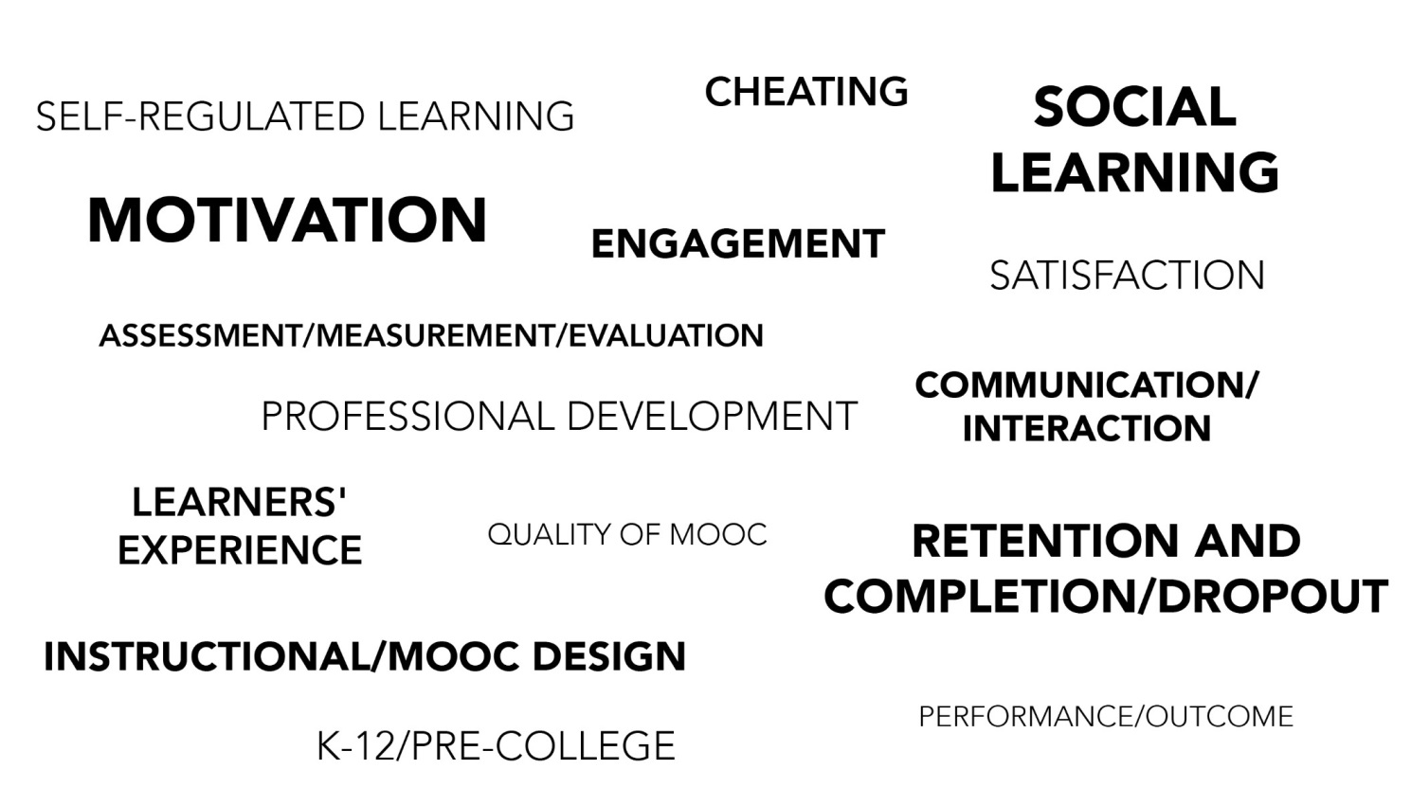
RQ2
  Specific Focus of MOOC Research (2014-2016)

Slide 41
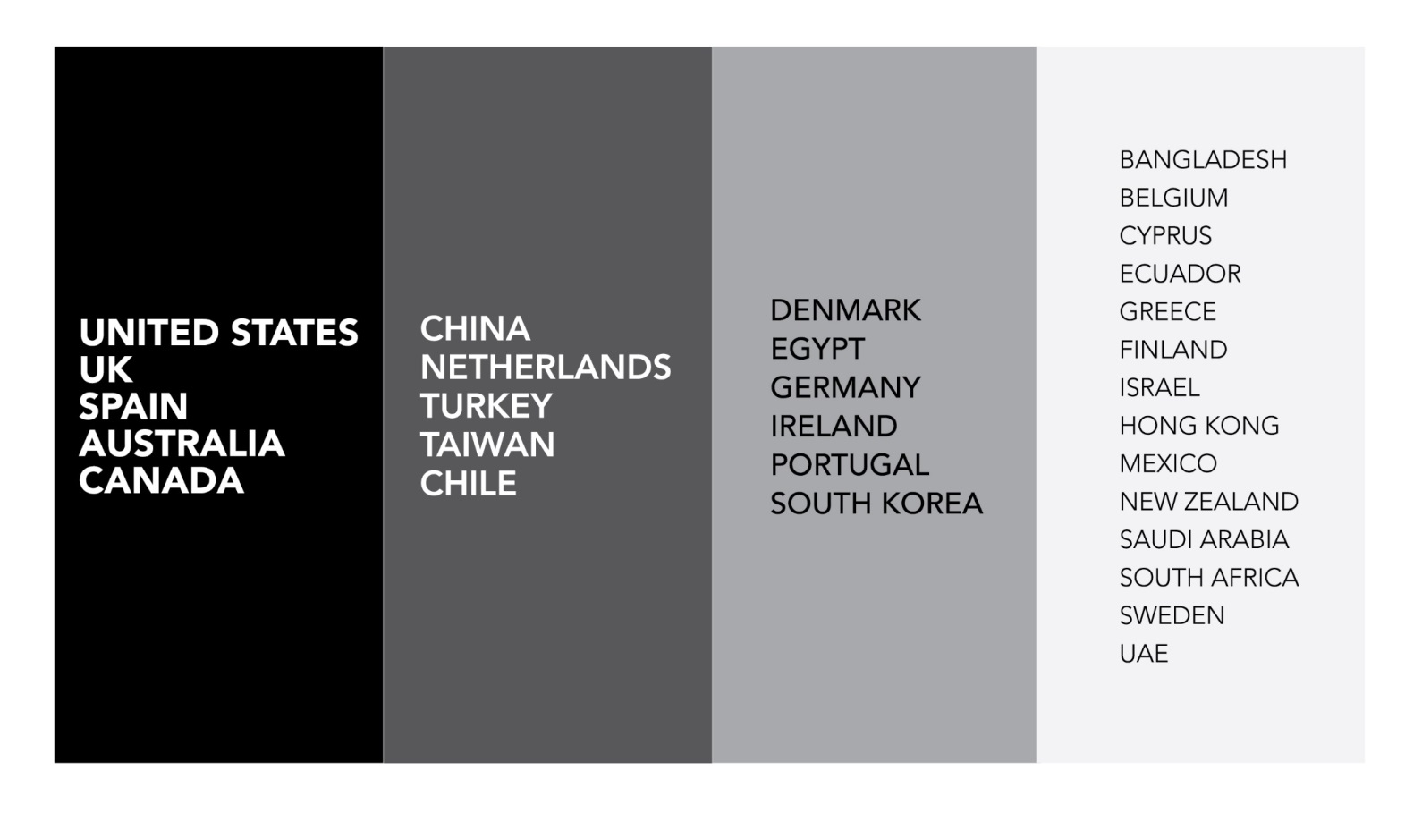
RQ3 Locations
Location of MOOC Research Team Members (2014-2016)

Slide 42

The study expanded!

Slide 43
Total Number of Empirical MOOC Studies Published in Different Journals from 2013-2018
Table 1
(Note: the table only includes the top nine journals in terms of the number of empirical MOOC studies)
Journals | Number of empirical studies
International Review of Research in Open and Distributed Learning | 51
Computers & Education | 22
British Journal of Educational Technology | 15
Online Learning | 12
Distance Education | 11
Journal of Online Learning and Teaching | 11
The Internet and Higher Education | 10
Computers in Human Behavior | 10
Open Learning | 8

Slide 44
Research Methods
Figure 2. Research methods used in empirical MOOCs studies from 2013-2018 (N=321 studies)

Slide 45
Data Collection Methods
Figure 5. Data collection methods used in empirical MOOCs studies from 2013-2018 (N = 321 studies)
(Note: some studies contain more than one data collection method and this figure only includes the main data collection methods)

Slide 46
Study #2
MOOCs Design
Considerations and Challenges
Zhu, M., Bonk, C. J., & Sari, A. (2018). Instructor experiences designing MOOCs in higher education: Pedagogical, resource, and logistical considerations and challenges. Online Learning, 22(4), 203-241.

Slide 47
Research Purpose
  The purpose of this study is to provide suggestions for future MOOC instructors and instructional designers in higher education through exploring MOOC design considerations and challenges from the instructor’s perspective.

Slide 48
Research Questions
  What are the design considerations of instructors when designing MOOCs?
  What challenges do instructors perceive when designing MOOCs?
  How do instructors address the challenges that they perceive related to MOOCs?

Slide 49

Research Design
  Sequential mixed methods design (Creswell & Clark, 2017)
Quan
Data Collection
Quan
Data Analysis
Qual
Data Collection
Interpretation of Entire Analysis
Qual
Data Analysis

Slide 50

Data Collection
  Data Collection:
    Survey, interview, and course review
  Participants:
    143 survey participants (10% response rate)
    12 interviewees

Slide 51
12 Interviewees
No. | Countries | Subject areas | Platforms
1. | The U.S. | Language and Literacy | Coursera
2. | The U.S. | Education | Coursera
3. | The U.S. | Education | Canvas
4. | The U.S. | Chemistry | Coursera
5. | UK | Medicine and Health | FutureLearn
6. | UK | Language and Literacy | FutureLearn
7. | Hong Kong (China) | Math | Coursera
8. | Mainland China | Math | Coursera
9. | Canada | Psychology | Coursera
10. | Australia | Medicine and Health | Open2Study
11. | Sweden | Computer Science | edX
12. | India | Management | edX

Slide 52
Data Analysis
RQs | Data Sources | Data analysis
RQ1 | Survey-multiple-choice questions Survey-open-ended questions Interview MOOC review | Descriptive statistics Content analysis (Elo & Kyngäs, 2008) Content analysis Content analysis
RQ2 | Survey-multiple-choice questions Survey-open-ended questions Interview | Descriptive statistics Content analysis Content analysis
RQ3 | Survey-multiple-choice questions Interview | Descriptive statistics Content analysis

Slide 53
Research Context

Slide 54
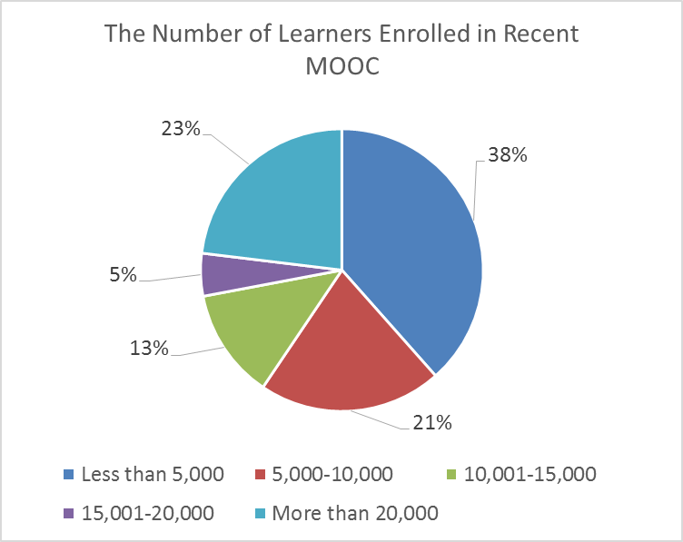
Research Context

Slide 55
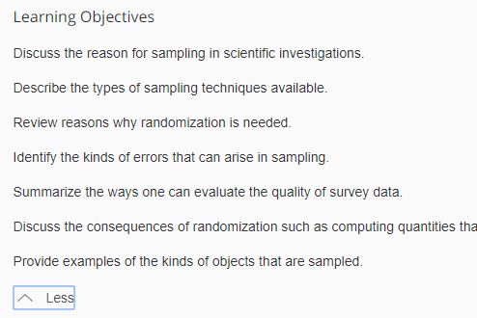
Findings RQ1
  RQ #1. What are the design considerations of instructors when designing MOOCs?
  Learning objectives
  Assessment
  Time for designing MOOC
  Engaging learners
An example of learning objectives:

Slide 56
RQ1 Survey Results

Slide 57

RQ1 Interview Results
  Engage learners
  One instructor from US mentioned:
    “I engaged people in the forum. So each week I would write a message that would be the new welcome page for the week that would say, ‘hey come to the forum and ask questions about this or come to the forum introduce yourself’... Of course, I tried to get students to feel like I was engaged with them during the videos by asking them questions and telling them to do things during the video.”

Slide 58

Findings RQ2
  RQ #2. What challenges do instructors perceive when designing MOOCs?
  Assessment methods
  Engaging students’ learning
  Time limitation
(Note: Above is an example of peer-assessment.)

Slide 59
RQ2 Survey Results

Slide 60

RQ2 Interview Results
  Time limitation
  One instructor from education subject mentioned:
    “I think one of the challenges is time. It does take a lot of time to get the videos done. I did not get a course release when I was doing, and it was a side project at the same time as my regular load.”

Slide 61

Findings RQ3
  RQ #3. How do instructors address the challenges that they perceive related to MOOCs?
  Explore other MOOC examples
  Seek help from the platform/colleagues/institutions

Slide 62
RQ3 Survey Results

Slide 63

RQ3 Interview Results
  Explore other MOOC examples
  One MOOC instructor from the US mentioned:
    “When I started making the MOOC, I could see MOOCs that other people had made. So I could see what other people did in terms of having videos with questions embedded in the videos, which I really liked.”

Slide 64
Implications
  For MOOC instructors
    May inform them about what other instructors are most concerned with and tend to target in MOOC design as well as their efforts in addressing the possible design challenges.
  For instructional designers
    Guide attention to ID in the areas that MOOC instructors might need them to help in consultation.

Slide 65
Study #3
MOOCs Instructional Design to Facilitate Participants’ Self-directed Learning

Slide 66

Key Terms
  Self-directed learning (SDL) (Garrison, 1997)
  (1) self-management
  (2) self-monitoring
  (3) motivation
Notes:
Garrison’s model: 3 inter-related part.

Slide 67
Research Background
  Learners need self-directed learning skills and strategies to be successful in MOOCs (Halawa, Greene, & Mitchell, 2014; Littlejohn & Milligan, 2016), as there is a lack of personalized interaction with teachers.
  Self-directness of a learner might vary in different learning environments which means that the learners could be more self-directed in one learning environment than another (Hiemstra, 1994).

Slide 68
Research Background
  Instructional design can greatly influence students’ interaction and engagement (Garrison & Cleveland-Innes, 2005) and success in online learning (Song, Singleton, Hill, & Koh, 2004; Swan, 2001).
  However, few studies have examined instructional design and the delivery of instruction using MOOCs from instructor perspectives (Margaryan et al., 2015; Watson et al., 2016); especially lacking is research on instructors’ perception of SDL and how they design MOOCs to facilitate students’ SDL.

Slide 69

Research Purpose
  The purpose is to inform instructors or instructional designers and MOOC providers of the current practices of designing MOOCs to facilitate learners’ SDL.

Slide 70
Research Questions
  How do MOOC instructors perceive participant SDL skills?
  How do MOOC instructors perceive their facilitation of participant SDL skills?
  How do instructors design and deliver MOOCs to facilitate participant SDL skills?
    a. How is technology being used by MOOC instructors to support the development of participant SDL skills?
    b. What technology features or functions do MOOC instructors want to have to improve their facilitation of MOOC participant SDL skills?

Slide 71

Research Design
  Explanatory sequential mixed methods design (Creswell & Clark, 2017)
Pilot survey with 48 instructors
Survey
198 instructors
Review 22 MOOCs of interviewees
Interview 22 instructors
Review 22 MOOCs of interviewees
Pilot interview with 4 instructors

Slide 72

Data Collections
  Survey:
  Volunteer sampling (Creswell & Clark, 2017)
  198 instructors responded to the survey (10% response rate)
  Interview:
  Homogeneous purposeful sampling (Creswell & Clark, 2017; Patton, 2002)
  Maximal variation sampling (Creswell & Clark, 2017)
  22 interviewees
  MOOC review:
  Reviewed 22 interviewees’ MOOCs

Slide 73
Pseudonym | Country | Subject area | Platform | Gender | No. of O/B | No. of M | Mode of the M
Lucas | US | Social science | edX | M | 0 | 1 | I without T
Branden | US | Education | Udacity | M | 0 | 5 or more | Self-paced
Logan | US | Literacy and Language | Coursera | M | 5 or more | 5 or more | I with T
Emma | US | Literacy and Language | Coursera | F | 2 | 1 | Self-paced
Jason | US | Science | edX | M | 1 | 1 | I with T
Jackson | US | Medicine and health | Coursera | M | 5 or more | 1 | Self-paced
Samuel | US | Education | FutureLearn | M | 4 | 3 | Self-paced
Hannah | US | Education | Blackboard | F | 5 or more | 1 | I with T
Ashley | US | Education | EdX | F | 0 | 5 or more | I with T
Andrew | UK | Art | FutureLearn | M | 0 | 3 | I with T
Emily | UK | Medicine and health | FutureLearn | F | 2 | 2 | I with T
Aiden | UK | Social science | FutureLearn | M | 0 | 1 | Self-paced
Henry | UK | Social science | FutureLearn | M | 0 | 1 | Self-paced
Joseph | UK | Medicine and health | FutureLearn | M | 1 | 1 | Self-paced
Joshua | UK | Literacy and language | FutureLearn | M | 2 | 2 | I with T
Mason | Australia | Education | Coursera | M | 5 or more | 1 | I with T
Ethan | Australia | Business | Coursera | M | 3 | 1 | I without T
Ben | Australia | Social science | edX | M | 1 | 1 | I with T
Paul | France | Computer Science | Coursera | M | 1 | 1 | I with T
Fernando | Belgium | Research methods | Blackboard | M | 5 or more | 3 | I with T
Jacob | Netherland | Science | Coursera | M | 0 | 1 | I with T
Dylan | Israel | Science | Coursera | M | 5 or more | 3 | I without T
Data Collections
  Interview:

Slide 74
Data Analysis
RQs | Data Sources | Data analysis | Tools
RQ1 | Survey Interview | Descriptive statistics Content analysis (Elo & Kyngäs, 2008) | SPSS NVivo
RQ2 | Survey Interview | Descriptive statistics Content analysis | SPSS NVivo
RQ3 | Interview Course review | Content analysis Content analysis | NVivo NVivo

Slide 75
Trustworthiness
  Validity survey: Experts review, think-aloud interview, and pilot test (EFA)
  Reliability survey: Pilot test and internal consistency reliability (Cronbach alpha)
  Triangulation: Data sources, researchers, and methods
  Member checks: Interview transcriptions
  Peer debriefing: Committee and colleagues
  Researcher reflexivity: Constant reflection and be forthright with our positions
  Thick description: Report the context, data sources, and analyses in detail
  Prolonged engagement: Immerse in instructors’ MOOCs before the interview and continue reviewing the MOOCs after the interview

Slide 76
Research Context

Slide 77
RQ1 Perceptions of SDL
  A majority of the MOOC instructors thought that these skills or attributes are not static, and that SDL as a set of skills can be educated or students’ personal attributes that can be changed.

Slide 78
RQ1 Interview Results
  Emma’s understanding of SDL is more related to self-management and motivation. She said:
    When I think about self-directed learning, I think about students managing their time and managing the coursework on their own, and how it fits into their schedules and their lives, how they interact with materials, what's going to keep them engaged.

Slide 79
RQ2 Perceptions of Facilitation of SDL
  Most of MOOC instructors thought that they can intentionally or unintentionally facilitate students’ SDL.

Slide 80
RQ2 Interview Results
  Ashely emphasized the importance of both instructors’ facilitation and students’ SDL skills. She said:
    The participant has a lot of flexibility on how they approach the content. I mean, obviously, we have things like assignments. We have things like online forums. And there're ways that we scaffold the learning experience. But there still is a lot of choice for the learner.

Slide 81
RQ3 Strategies to Facilitate SDL
  Students’ intrinsic motivation plays an important role. However, extrinsic motivation provided by the MOOCs might help transfer extrinsic motivation to intrinsic motivation.
Motivations | Strategies
Entering motivation | MOOC instructors helped students identify the needs and goals of learning and sense of achievement.
Task motivation | MOOC instructors motivated students through instruction, learning materials, feedback, and learning community.

Slide 82


RQ3 Learning Community

Slide 83
RQ3 Strategies to Facilitate SDL
  Both internal feedback and external feedback were provided to help students’ self-monitoring.
Self-monitor |  | Strategies
Internal feedback | Cognition | MOOC instructors provided quizzes for self-assessment, tutorial on technology use, learning advice, navigation of the course, progress indicators, resources, and instructional modeling, etc.
 | Meta-cog | MOOC instructors encouraged students to reflect and think critically by providing reflection questions and building learning community.
External feedback |  | MOOC instructors, teaching assistants, and peers were involved in providing external feedback.

Slide 84


RQ3 Self-assessment (i.e., embedded quizzes)

Slide 85

RQ3 Progress Indicators

Slide 86

RQ3 External Feedback: Peer-assessment
(e.g., 3 peers assigned to review each assignment)

Slide 87
RQ3 Strategies to Facilitate SDL
  They helped students’ self-management concerning setting learning goals, time management, resources and support management although among the three elements of SDL, MOOC instructors had less control over students’ management.
Self-management | Strategies
Enactment of learning goals | Providing discussion questions, reflections, survey, and appreciation students’ learning goals.
Time management | Providing time frame, progress indicator, short learning units, and flexible timeline.
Management of resources and support | Providing flexible learning resources, peer-assessment, accessibilities, clear expectations, and short learning units.

Slide 88

RQ3 Time Management
(e.g., time advisories and estimates)

Slide 89






RQ3-a. Tech Used for SDL
  Synchronous communication technologies
    Google Hangouts YouTube Live
  Asynchronous communication technologies
    Discussion forum Blog Slackbot Flickr
  Multimedia (e.g., video and graphics)
  Feedback technologies

Slide 90

RQ3-b. Tech Expectations for SDL
  Adaptive learning systems
  Artificial intelligent systems
  Learning analytics
  Interactive technologies
    Interaction between learners and content
    Interaction among learners and other participants
  Tools embedded in platforms

Slide 91
Discussion
  SDL can be Changed
  MOOC Instructors can Facilitate SDL
  Strategies to Facilitate SDL: A variety of strategies can be used to facilitate student SDL skills in terms of motivation, self-monitor, and self-management.
  Tech for SDL: Tech plays an important role in facilitating SDL skills.
  Tech expectations: Adaptive learning systems, artificial intelligent systems, and learning analytics were expected to have to support SDL.

Slide 92


Top 10 Strategies to Facilitate SDL in MOOCs
  Helping students set their own learning goals;
  Building learning community;
  Offering immediate feedback;
  Embedding quizzes for self-assessment;
  Providing progress indicators;
  Providing reflection questions;
  Designing short learning units;
  Providing flexible timelines;
  Highlighting estimated time frames;
  Making available optional learning materials.

Slide 93
Other Related MOOC Studies
Sari, A. R., Bonk, C. J., & Zhu, M. (in revision). MOOC Instructor Designs and Challenges: What can be Learned from Existing MOOCs in Indonesia and Malaysia? Asia Pacific Education Review.
Zhu, M., Bonk, C. J., & Sari, A. (in press). MOOC Instructor Motivations, Innovations, and Designs: Surveys, Interviews, and Course Reviews. Canadian Journal of Learning & Tech.
Doo, M., Tang, Y., Bonk, C. J., & Zhu, M. (in review). A Mixed Methods Look at Motivation and Career Development of MOOC Instructors. Australasian Journal of Educ. Technology.
Bonk, C. J., Sabir, N., Sari, A., Zhu, M., Xu., S., & Kim, M. (in preparation). MOOC instructors’ efforts to address learner diversity in design and implementation.
Zhu, M., Sari, A. R., & Bonk, C. J. (in preparation). Systematic review of MOOC research from 2012-2019. (Intended for special issue of ETR&D)
Doo, M., Zhu, M., Bonk, C. J., & Tang, Y. (data collect). MOOC instructor engagement.
Zhu, M., & Bonk, C. J. (data collect). MOOC Student Perceptions of Effective SDL Strats.

Slide 94

Tired of MOOCs…?

Slide 95
Do we have time for another study?

Slide 96

Other Related MOOC Studies

Slide 97
Figure 1. MOOC instructor departmental or primary discipline affiliations (n=150)

Slide 98
Figure 3 and 4. Effort placed on meeting unique learner needs when designing and delivering most recent MOOC
(Note: on a scale of 1 (low) to 10 (high) (n=144)

Slide 99

Figure 6. Number of MOOCs that offer different types of learning system automation and adaptation (n=127)

Slide 100
Figure 9: MOOC instructors (n=133) instructional practices to address cultural diversity

Slide 101

Table 1. Instructional Practices of MOOC Instructors to Address the Variety of Student Competencies and Needs (n=142)

Slide 102

What’s the Future?

Slide 103
Possibile Future Trends…?
  Stackable Degrees (i.e., microcredentials lead to degree programs)
  Unique Partnerships for MOOC programs
  AI Grading and Feedback Mechanisms
  Adaptive Technologies…Adaptive Learning

Slide 104
30+ Ways Learning is Changing:
Recapping the Three Mega Trends:
Engagement, Access, and Customization

Slide 105

January 31, 2019
MOOC Markets to 2023: Global Analysis & Outlook - Postgraduate User Type to Grow at the Highest CAGR During the Forecast Period
Research and Markets, GlobalNewsWire https://globenewswire.com/news-release/2019/01/31/1708670/0/en/MOOC-Markets-to-2023-Global-Analysis-Outlook-Postgraduate-User-Type-to-Grow-at-the-Highest-CAGR-During-the-Forecast-Period.html

Slide 106


February 27, 2019
Why 'The Future Is Asian' Should Inform Your University's Strategy
Joshua Kim, Inside Higher Ed https://www.insidehighered.com/blogs/technology-and-learning/why-future-asian-should-inform-your-universitys-strategy
Today, there are about 70 million East Asian and Pacific students enrolled in postsecondary education. By 2040, that number is projected to rise to 257 million.

Slide 107

February 27, 2019
Thinking About 'Massification of Higher Education Revisited’
Joshua Kim, Inside Higher Ed https://www.insidehighered.com/blogs/technology-and-learning/thinking-about-massification-higher-education-revisited%E2%80%99

Slide 108
February 27, 2019
Thinking About 'Massification of Higher Education Revisited’
Joshua Kim, Inside Higher Ed https://www.insidehighered.com/blogs/technology-and-learning/thinking-about-massification-higher-education-revisited%E2%80%99
I’ve been looking at a 2018 report prepared by Angel Calderon of Australia’s RMIT University. The report is called Massification of Higher Education Revisited.
Some key findings:
Global postsecondary enrollments are projected to increase from 214.1 million in 2015 to 594.1 million in 2040.
The number of students enrolled in higher education institutions in East Asia & the Pacific is projected to increase from 69.4 million in 2015 to 257.6 million in 2040.
In South & West Asia, similar projections are an increase of 42.4 million students in 2015 to 160.4 million in 2040.
Latin America & the Caribbean will see higher education enrollment going from 25.3 million in 2015 to an expected 65.6 million in 2040.
The Arab States are projected to see an increase of postsecondary enrollments from 10.7 million in 2015 to 22.3 million in 2040.
Sub-Saharan Africa will see university enrollments grow from 7.4 million in 2015 to 21.7 million in 2040.
During this same period, the number of students studying in the U.S. and Western Europe will grow only from 37.5 million (2015) to a projected 43.7 million in 2040.

Slide 109

June 2018
Massification of Higher Education Revisited
Angel J. Calderon, Analytics & Insights, Melbourne, Australia https://www.academia.edu/36975860/Massification_of_higher_education_revisited

Slide 110

June 2018
Massification of Higher Education Revisited
Angel J. Calderon, Analytics & Insights, Melbourne, Australia https://www.academia.edu/36975860/Massification_of_higher_education_revisited

Slide 111



Thank you!
Any Questions?
Curtis Bonk: cjbonk@Indiana.edu
Meina Zhu: meinzhu@iu.edu
Slides and Proceedings Paper at TrainingShare.com: http://www.trainingshare.com (go to “Archived Talks”)

